Slide 1


Project Update
April 2nd, 2024
The Third vLLM Meetup
hosted by Roblox

Slide 2

🙏 Thank you Roblox for Hosting!

Slide 3
Topics
vLLM Overview
Project Update
Development Roadmap

Slide 4
Topics
vLLM Overview
Project Update
Development Roadmap

Slide 5



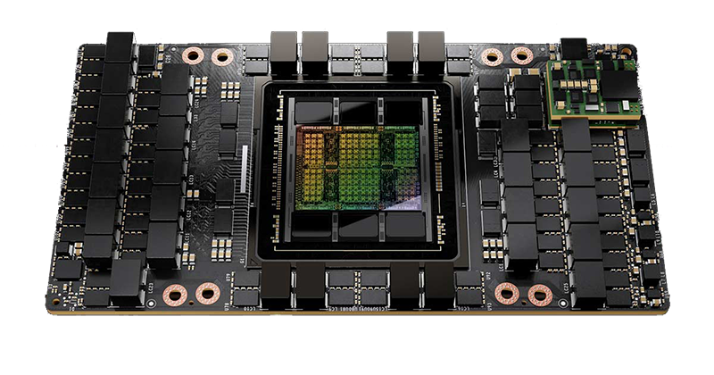
The era of Large Language Models (LLMs)
Chat
Program
Search
Served by
GPUs

Slide 6
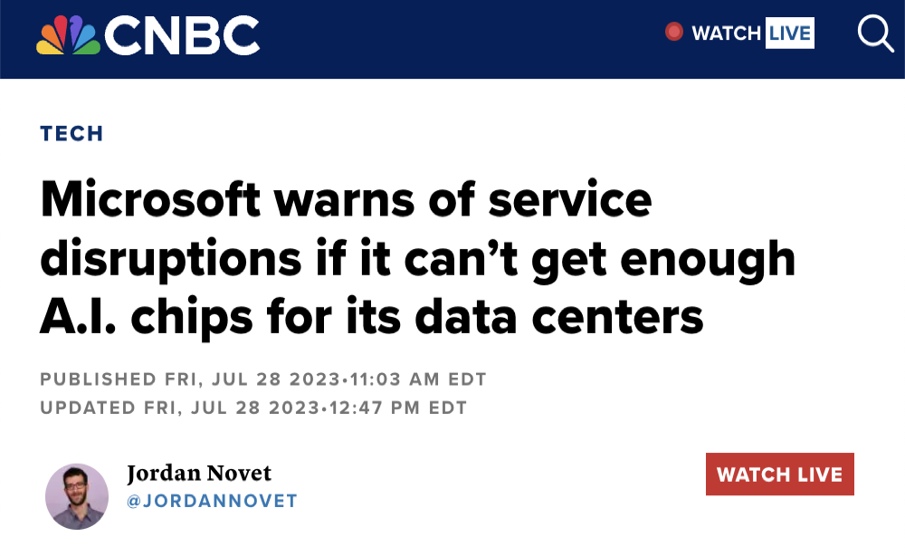
Serving LLMs is (surprisingly) slow and expensive
A single A100 GPU can only serve < 1 request per second
Moderate size of model (13B parameters) and input
A ton of GPUs are required for production-scale LLM services

Slide 7
Our Goal
Build the fastest and
easiest-to-use open-source
LLM inference & serving engine

Slide 8
PagedAttention
An attention algorithm that allows for storing continuous keys and values in non-contiguous memory space.

Slide 9
Manage KV cache like OS virtual memory
Physical KV blocks
Block Table
computer | scientist | and | mathe- matician
Artificial | Intelli- gence | is | the
renowned
future | of | tech- nology
Alan | Turing | is | a
Block Table
Request
A
Request
B
Logical KV blocks
Logical KV blocks
Alan | Turing | is | a
computer | scientist | and | mathematician
renowned
Artificial | Intelli- gence | is | the
future | of | tech- nology

Slide 10



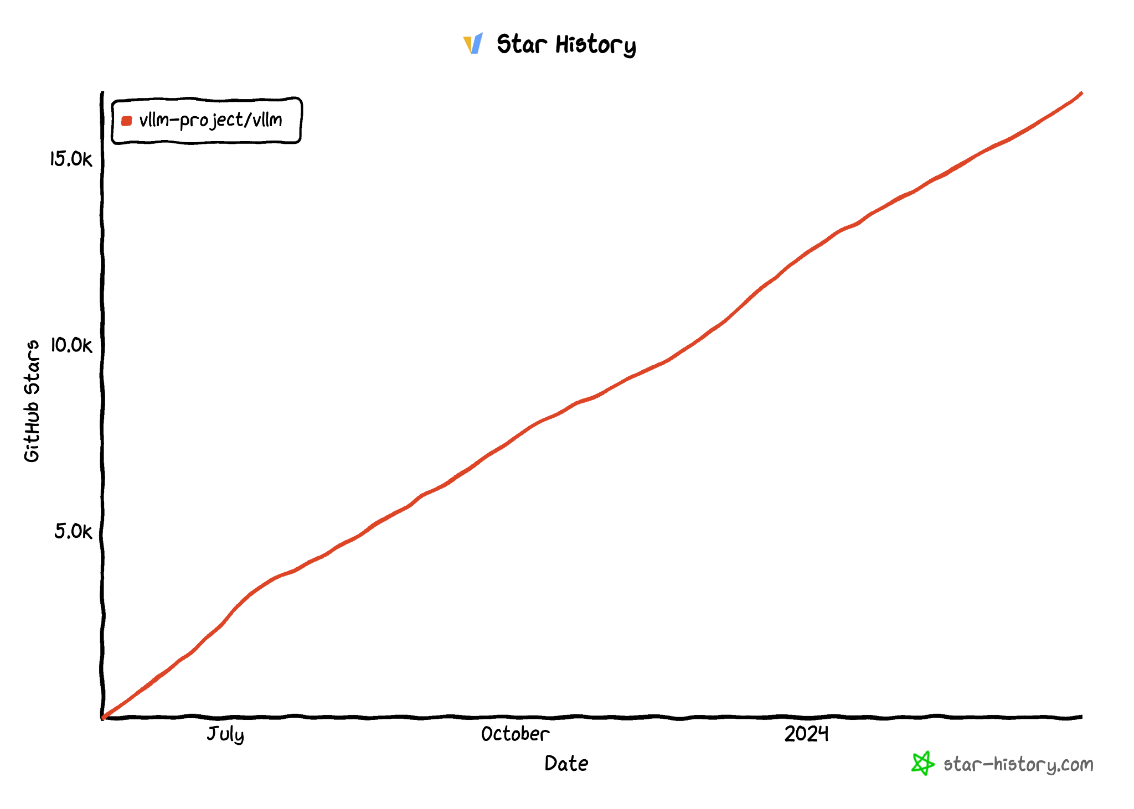
vLLM Github Repo
https://github.com/vllm-project/vllm
$ pip install vllm
17K Stars
Official
release!

Slide 11
vLLM API (1): LLM class
A Python interface for offline batched inference
from vllm import LLM
# Example prompts.
prompts = ["Hello, my name is", "The capital of France is"]
# Create an LLM with HF model name.
llm = LLM(model="meta-llama/Llama-2-7b-hf")
# Generate texts from the prompts.
outputs = llm.generate(prompts)

Slide 12
vLLM API (2): OpenAI-compatible server
A FastAPI-based server for online serving
Server
$ python -m vllm.entrypoints.openai.api_server --model meta-llama/Llama-2-7b-hf
Client
$ curl http://localhost:8000/v1/completions \
-H "Content-Type: application/json" \
-d '{
"model": "meta-llama/Llama-2-7b-hf",
"prompt": "San Francisco is a",
"max_tokens": 7,
"temperature": 0
}'

Slide 13



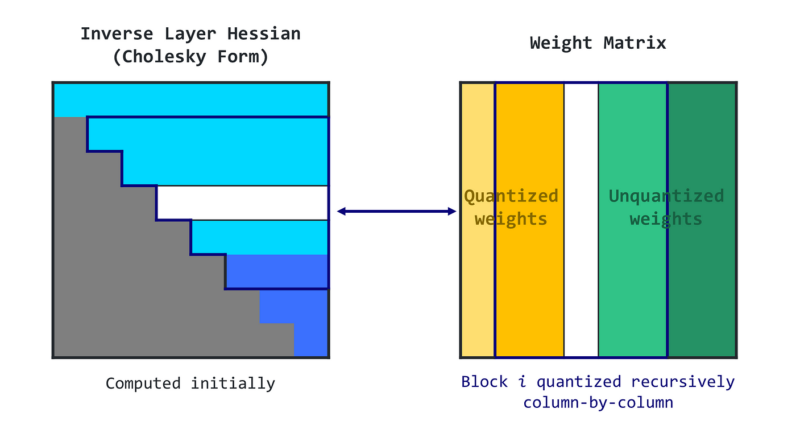
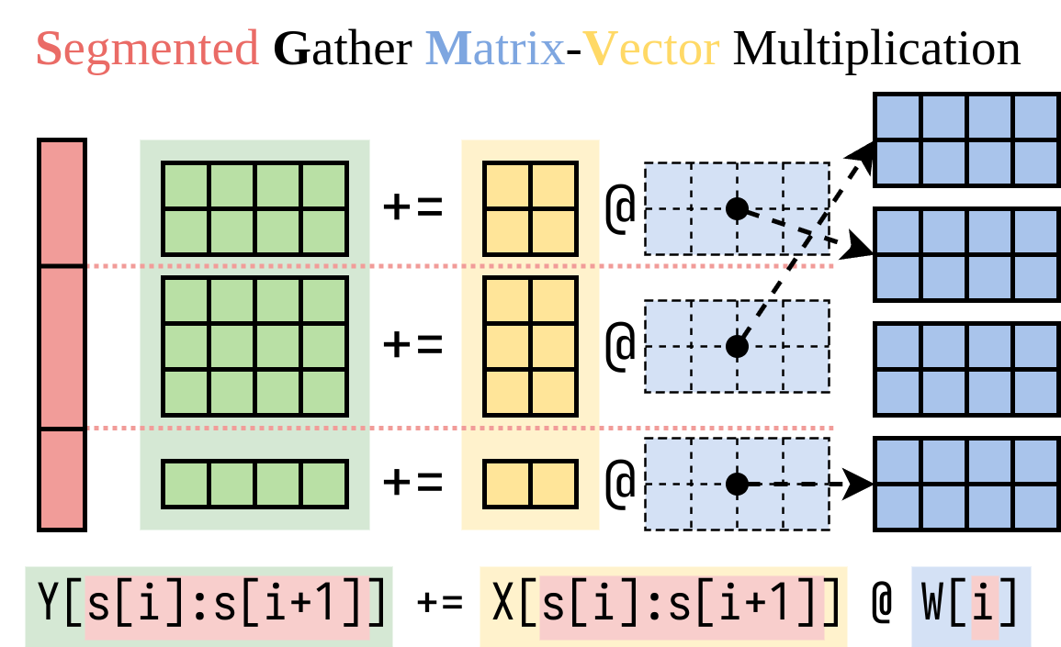
Features
Wide range of models
33+ model architectures (llama, mixtral, gemma, etc)
New architecture added within days of announcement
Wide range of hardware architectures
NVIDIA GPUs: from T4 to H100
AMD GPUs: from MI210x to MI300x
AWS Inferentia and Trainium
Intel/AMD CPUs
Coverage of Inference Optimizations
Quantization (GPTQ, AWQ, SqueezeLLM, FP8 KV Cache)
Prefix Caching
Multi-LoRA
Tensor parallelism

Slide 14
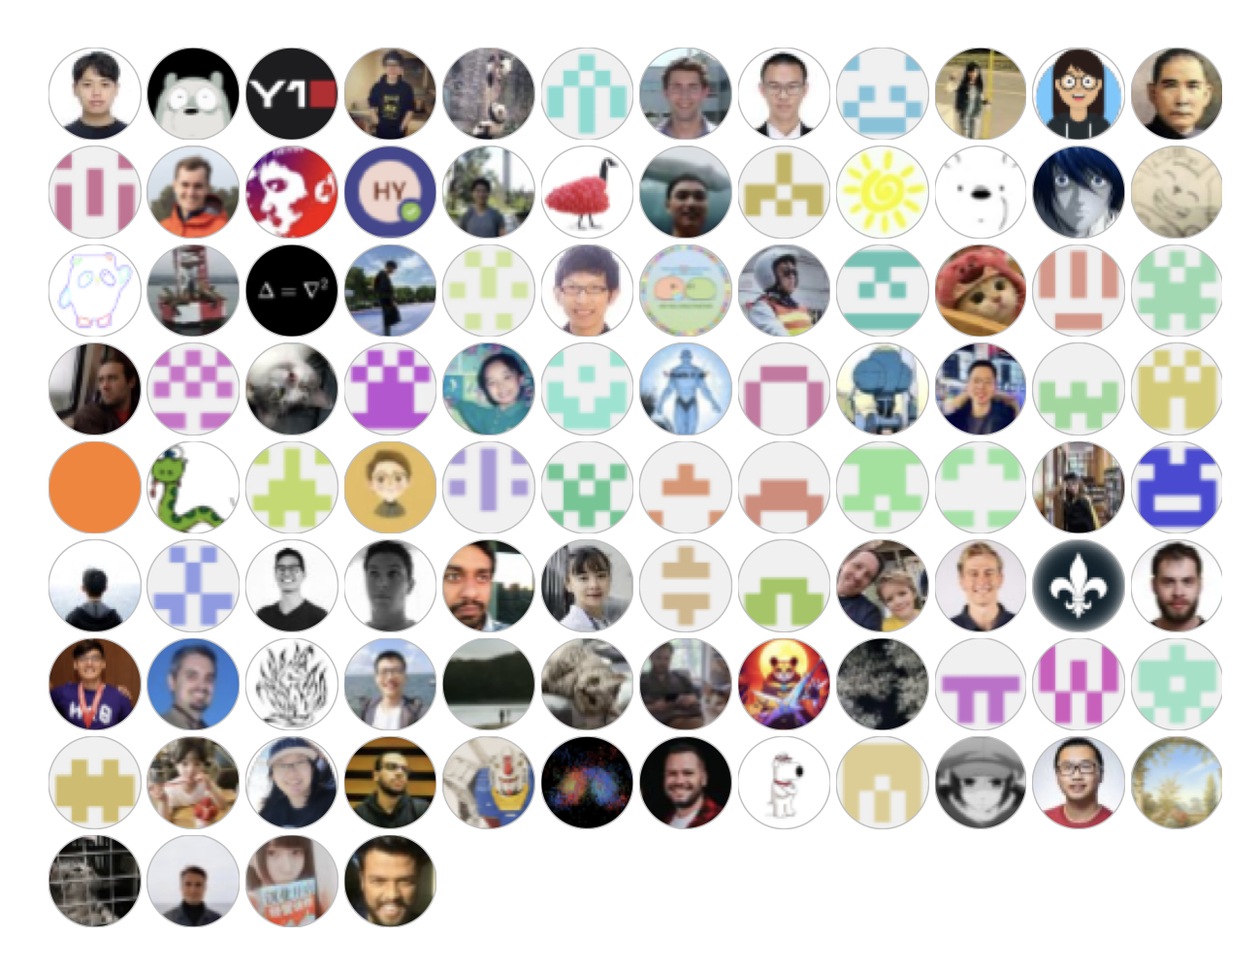
Contributors
Thanks to 277+ contributors who raised issues, participated in discussions, and submitted PRs!
…

Slide 15























vLLM Adopters
Open-Source Projects
Companies
lm-sys/FastChat
EleutherAI/lm- evaluation-harness
allenai/open-instruct
outlines-dev/outlines
…
…

Slide 16
Default LLM Serving Engine on Microsoft Azure
Our default choice for serving models is vLLM, which provides high throughput and efficient memory management with continuous batching and Paged Attention.
– Rashaud Savage, Microsoft Azure
Source: https://aka.ms/OpenModels

Slide 17
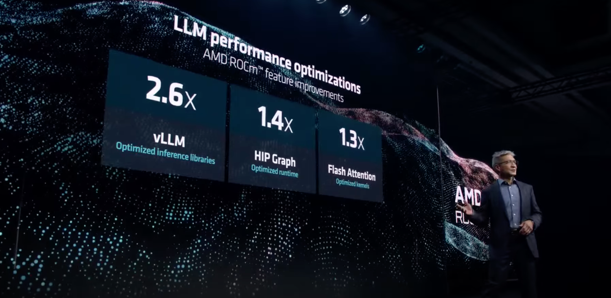
Featured at AMD MI300x Launching event
Source: AMD Presents: Advancing AI

Slide 18
Topics
vLLM Overview
Project Update
Development Roadmap

Slide 19
Updates since last meetup (Feb & March)
Model Support
Hardware Support
Features
Performance Optimization
Refactoring
OSS Community

Slide 20
Updates since last meetup (Feb & March)
Model Support
Hardware Support
Features
Performance Optimization
Refactoring
OSS Community

Slide 21



Supported Models
Community support of 30+ different model architectures, covering most of the popular LLMs
New model with day-1 support:
Qwen2 MoE (from the model vendor)
DBRX (from the model vendor)
Command-R (from the model vendor)
Gemma (from the model vendor)
StarCoder2 (from community support)
Other new models highlights:
XVerse
Jais
OLMo

Slide 22

Vision Language Model: LLaVA (@xwjiang2010)
With PR #3042, vLLM start to support vision language models.
Support both image input/feature input
See examples/llava_example.py for example usage

Slide 23
Updates since last meetup (Feb & March)
Model Support
Hardware Support
Features
Performance Optimization
Refactoring
OSS Community

Slide 24






Expanding Hardware Support
Better support for AMD
10+ PRs, tested in vLLM CI.
Better support for AWS Neuron
Refactoring (PR #3471), CI/CD (PR #3571)
Initial support for Intel CPUs (PR #3634)
Prototype for Intel GPUs (PR #2378)
Prototype for Intel Habana Gaudi (Repo)
Active work on Google TPUs (RFC)
Trainium/Inferentia
Google TPU

Slide 25
Updates since last meetup (Feb & March)
Model Support
Hardware Support
Features
Performance Optimization
Refactoring
OSS Community

Slide 26
Automatic Prefix Caching (by @SageMoore, @ElizaWszola, @mgoin)
Example 1: Multi-round conversation
Prompt (round 1)
Human: What's AI?
LLM Result (round 1)
LLM: AI is technology that simulates human intelligence, like Siri or Google Maps.
Prompt (round 2)
Human: What's AI?
LLM: AI is technology that simulates human intelligence, like Siri or Google Maps.
Human: Cool, thanks!
LLM Result (round 2)
LLM: No problem!
Cached

Slide 27
Automatic Prefix Caching (by @SageMoore, @ElizaWszola, @mgoin)
Example 2: Shared system prompt
Request A
A chat between a curious user and an artificial intelligence assistant. The assistant gives helpful, detailed, and polite answers to the user's questions. User: Hello!
Request B
A chat between a curious user and an artificial intelligence assistant. The assistant gives helpful, detailed, and polite answers to the user's questions. User: How are you?
Request C
A chat between a curious user and an artificial intelligence assistant. The assistant speaks French. User: Bonjour!

Slide 28
Automatic Prefix Caching (by @SageMoore, @ElizaWszola, @mgoin)
All prefixes are automatically cached in vLLM’s paged memory. New requests can directly use the cached prefix without recomputation.
When running out of blocks, the partial prefixes will be freed with LRU order.
Implemented in PR #2762. Enable the feature by passing --enable-prefix-caching

Slide 29
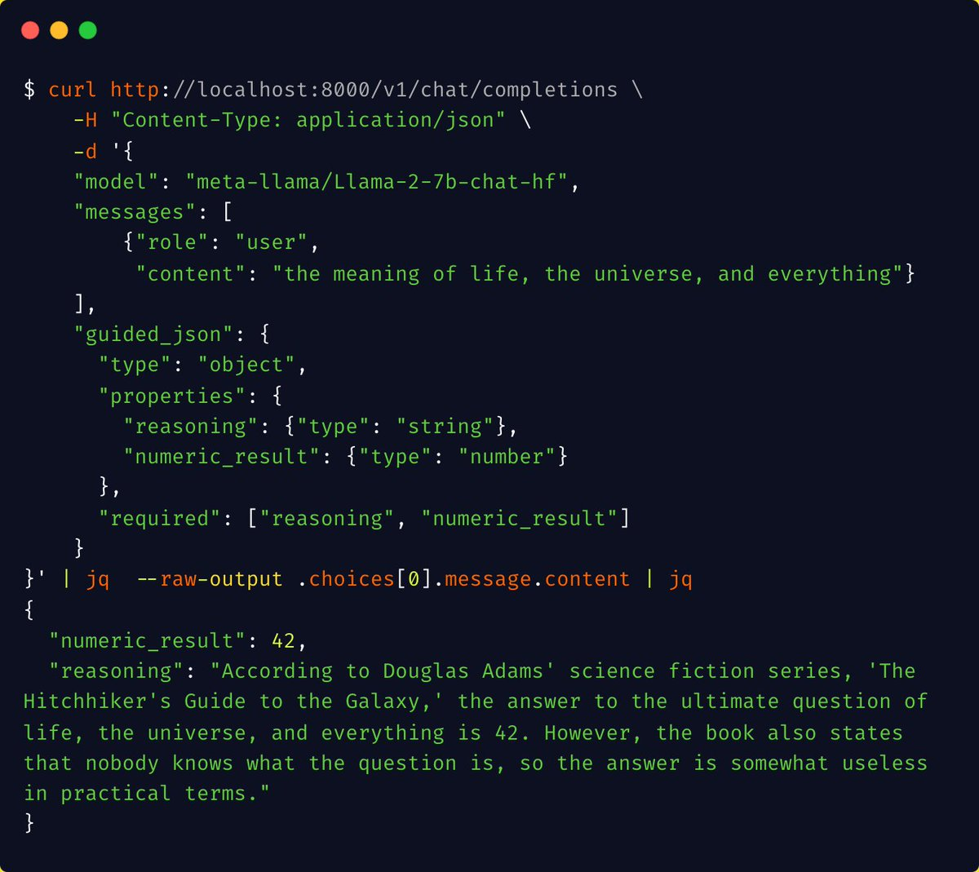
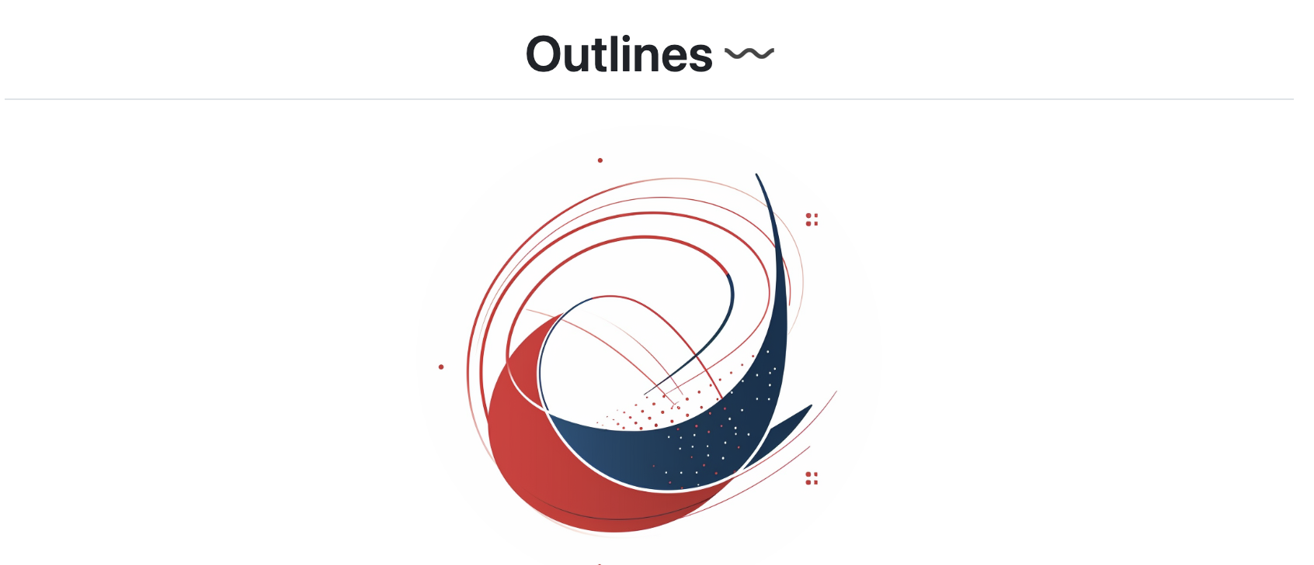
Guided Decoding (by @felixzhu555, @br3no, @simon-mo)
Support via Outlines
Support for Regex, JSON Schema, Grammar
OpenAI compatibility
*function calling work in progress

Slide 30
Updates since last meetup (Feb & March)
Model Support
Hardware Support
Features
Performance Optimization
Refactoring
OSS Community

Slide 31
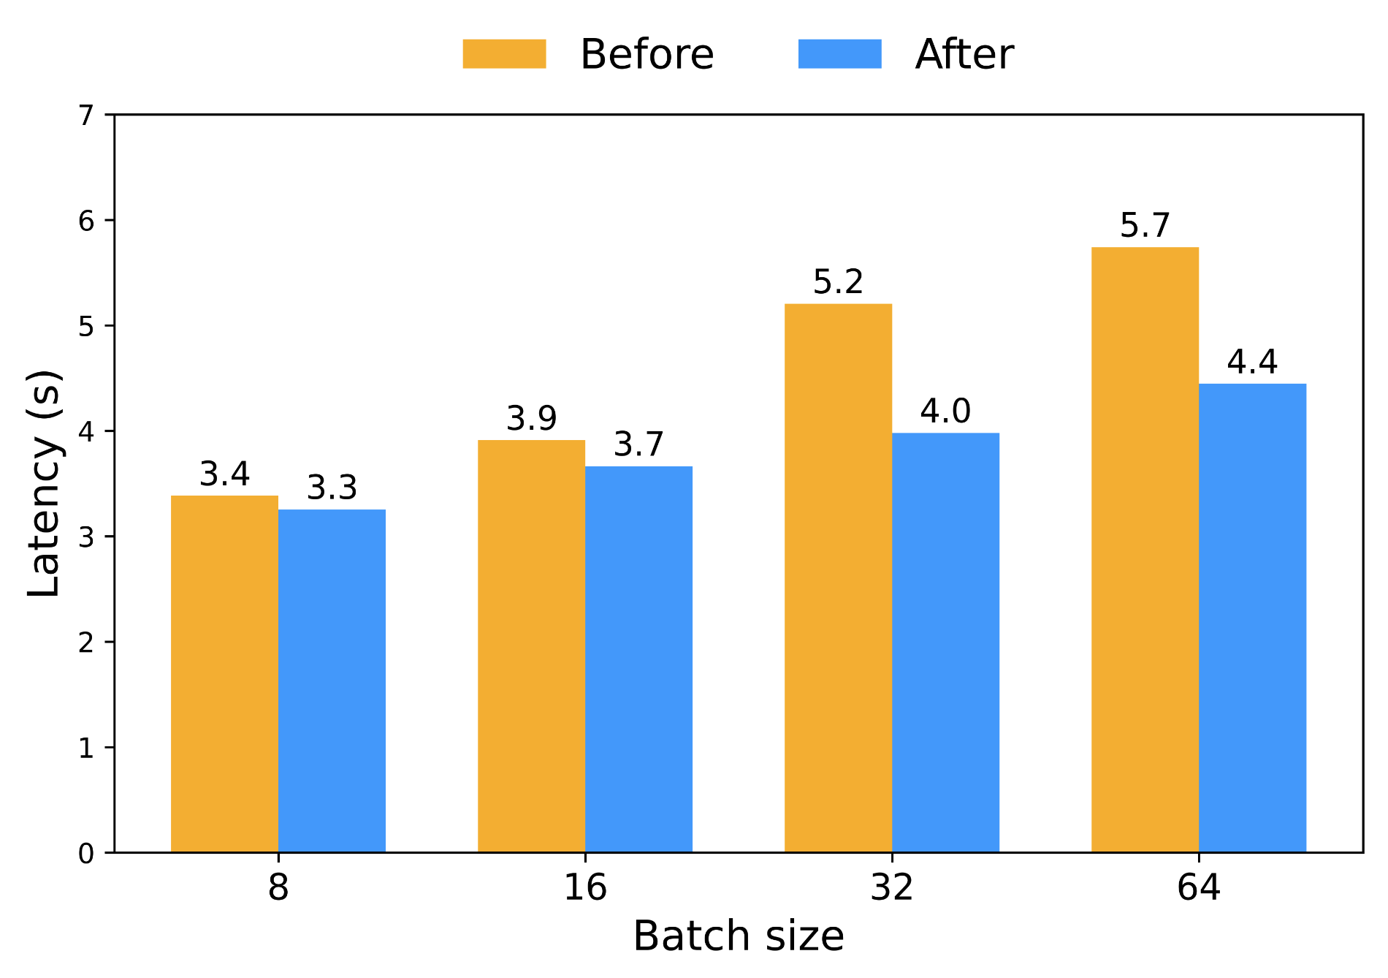
Performance: Optimized MoE Kernels
Triton grouped GEMM kernel with tuned tile sizes
Up to 20% E2E latency reduction (DBRX)
Grouped GEMM
Expert 0
Expert 0
Expert 0
Expert 0
Tokens routed to Expert 0
Tile sizes

Slide 32
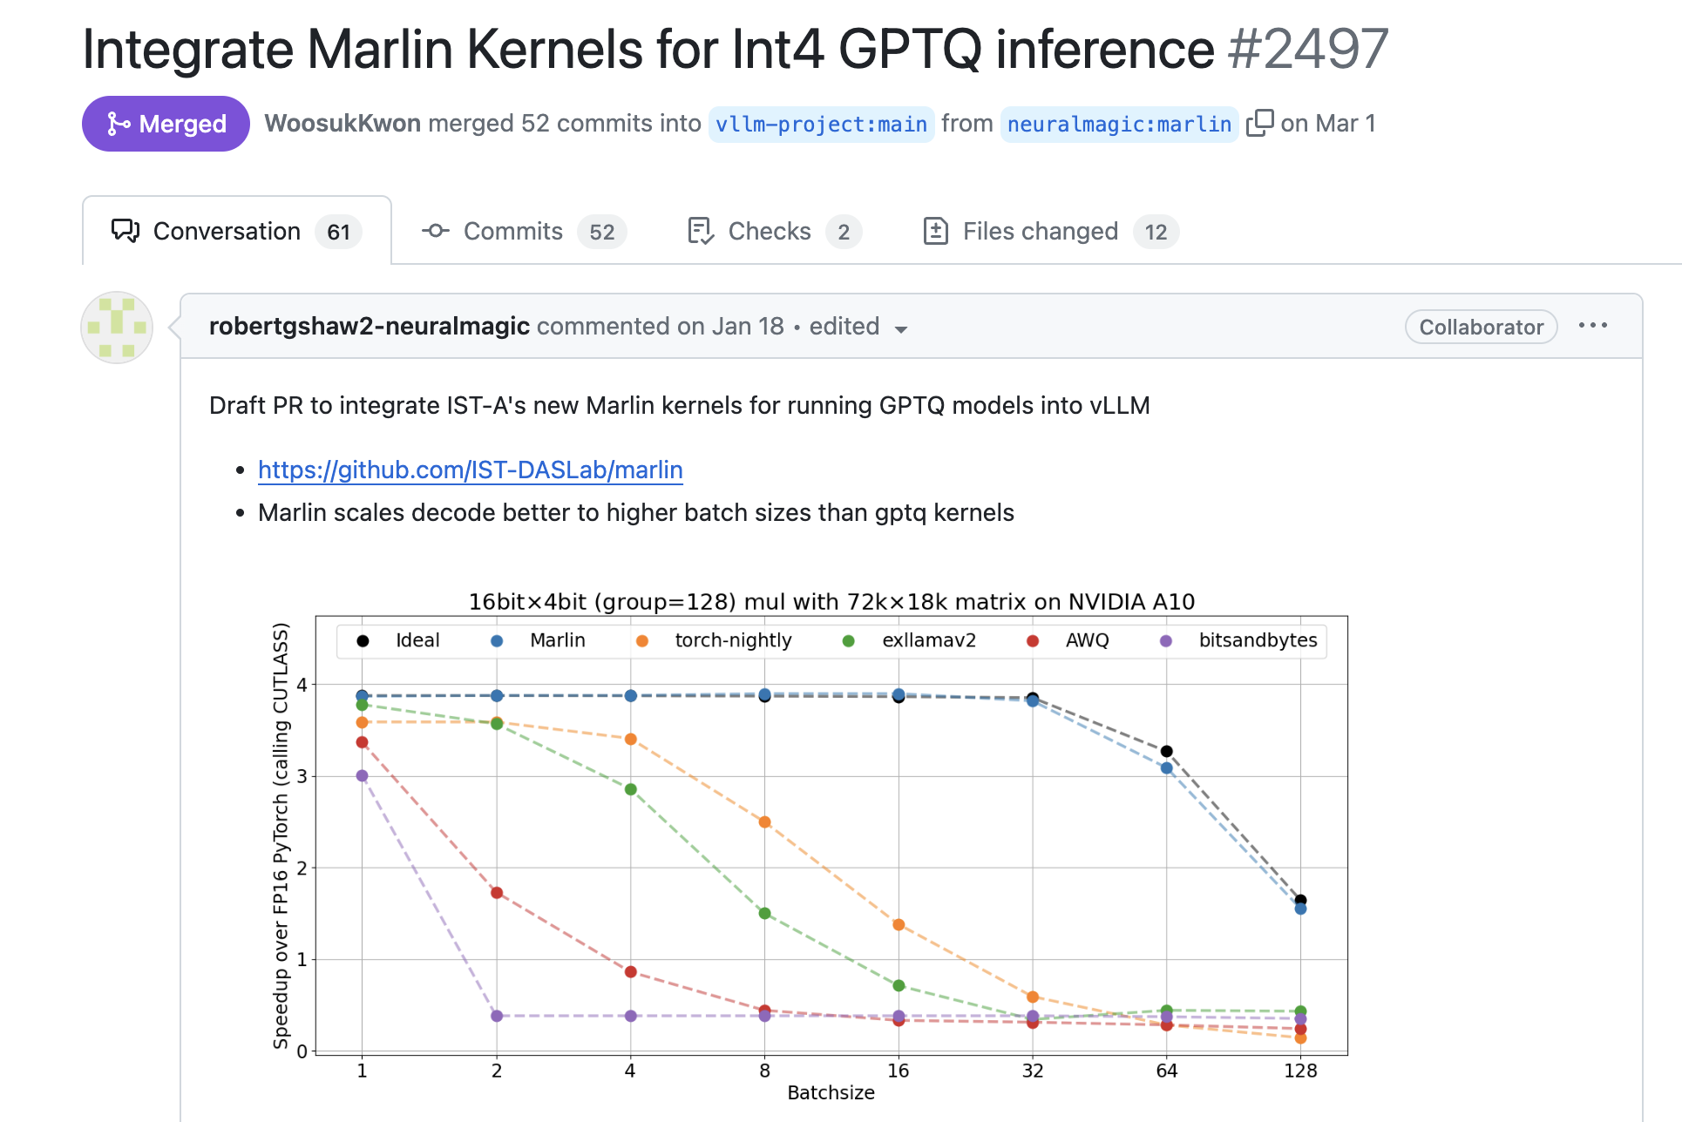
Performance: Marlin Kernel for Quantization

Slide 33



Speculative Decoding @cadedaniel
Lookahead Scheduler
(schedule more than 1 slots)
Draft Model
KV
Target Model KV
Speculative Worker
Draft Worker
Target Worker
Rejection Sampler
Small Draft model
In the future:
Other propose methods (ngram, RAG, …)
Score
Accept
Propose

Slide 34
Updates since last meetup (Feb & March)
Model Support
Hardware Support
Features
Performance Optimization
Refactoring
OSS Community

Slide 35
Refactoring: Attention Backend
Goal: Easily plug in different attention implementations for different hardware and models
query
Attention
Metadata
key
value
Attention Abstraction
flash-attn
Backend
xFormers
Backend
ROCm + Triton
Backend
PyTorch SDPA
Backend

Slide 36
Refactoring: Model Executor
Goal: Easy to add support for new hardware and isolate code for different hardware
LLM Engine
Distributed runtime management
GPU
Executor
CPU
Executor
Inferentia
Executor
Worker on a single GPU
GPU
Worker(s)
CPU
Worker(s)
Inferentia Worker(s)
Model
transformers-neuronx
Model
NVIDIA GPU Custom Ops
AMD GPU Custom Ops
Intel CPU Custom Ops
NVIDIA GPU kernels
AMD GPU kernels
Intel CPU kernels

Slide 37
Updates since last meetup (Feb & March)
Model Support
Hardware Support
Features
Performance Optimization
Refactoring
OSS Community

Slide 38
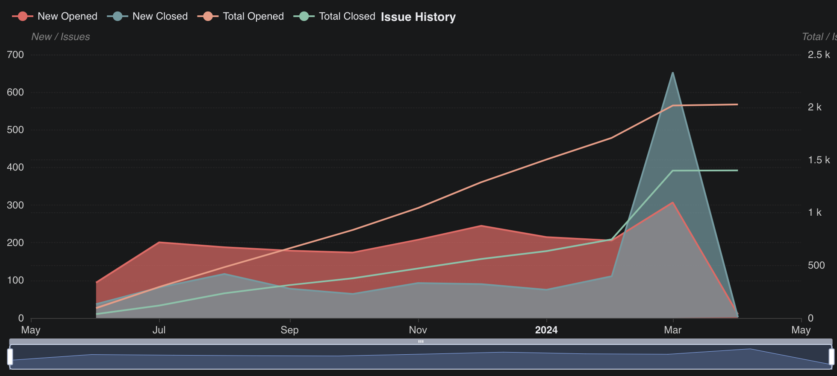
Thanking our community!
Thank you @hmellor!

Slide 39
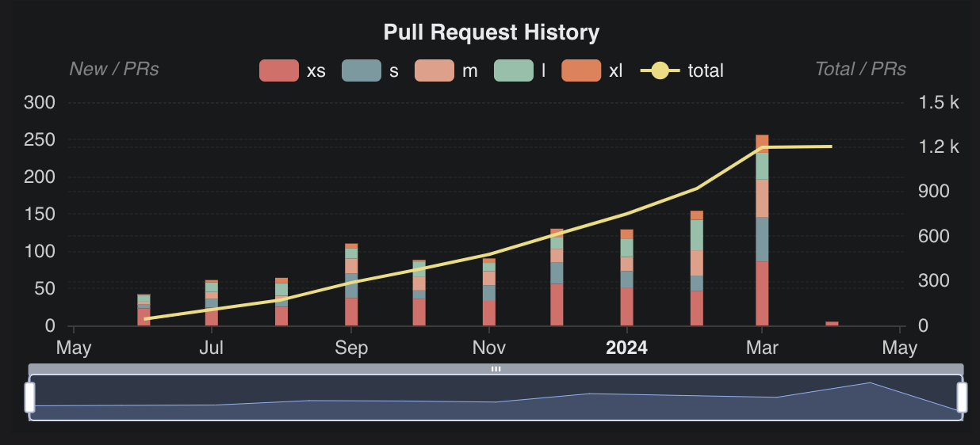
Thanking our community!

Slide 40












Welcome New Committers
@WoosukKwon
@zhuohan123
@simon-mo
@LiuXiaoxuanPKU
@Yard1
@esmeetu
@youkaichao
@pcmortiz
@njhill
@ywang96
@cadedaniel
@robertshaw2-neuralmagic

Slide 41
Topics
vLLM Overview
Project Update
Development Roadmap

Slide 42
High Level Goals
Broad Model Support
Excellent Hardware Coverage
Production Level Engine
Performance Optimization
Extensible Architectures
Strong OSS Community

Slide 43
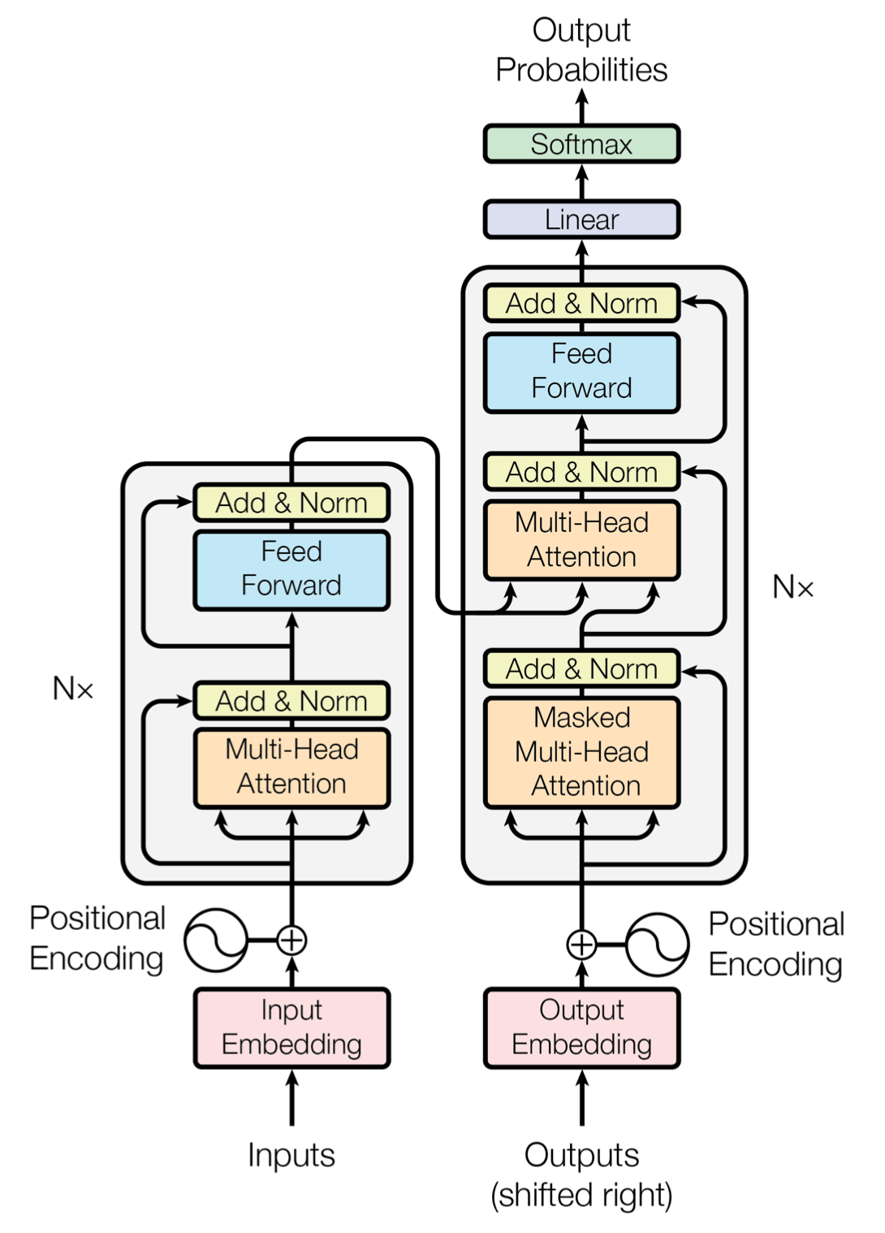
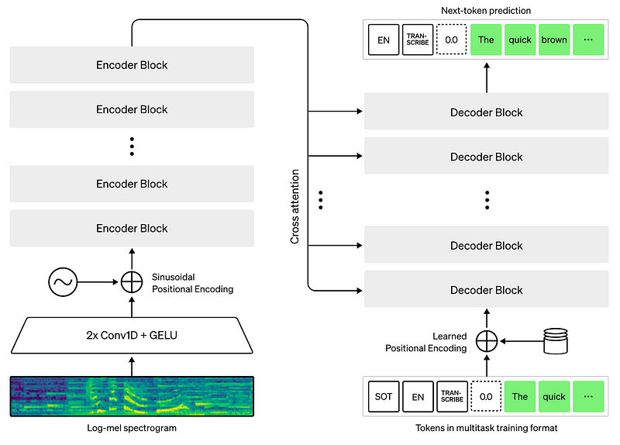
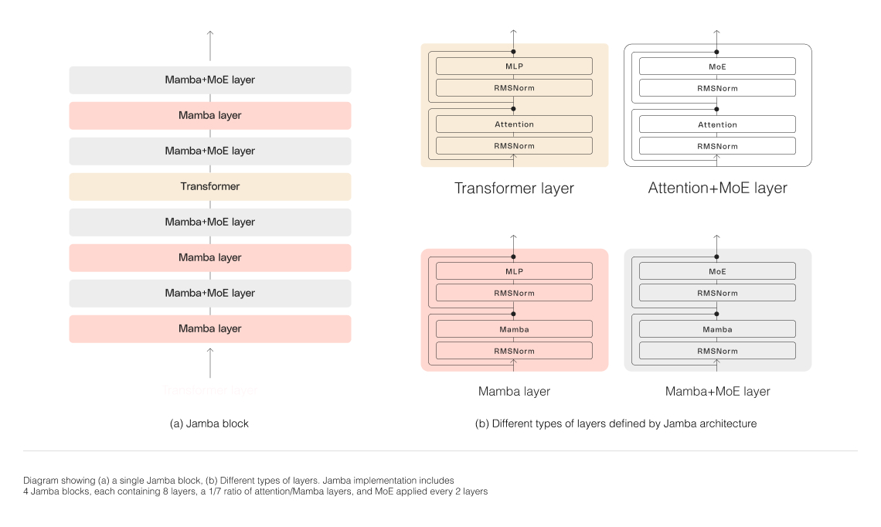
Broad Model Support
Encoder decoder model
T5, Whisper, bge
Hybrid Architecture (Jamba)
More vision models

Slide 44
Excellent Hardware Coverage
Continue support + Active collaboration:
GPUs: NVIDIA, AMD, Intel GPU
Tensor Accelerators: Google TPU, AWS Inferentia, Habana Gaudi
CPU: Intel/AMD CPU

Slide 45
Production Level Engine
Speculative Decoding Framework
Adding variety of algorithms
Support custom
Explore Medusa/Eagle
Chunked Prefill Scheduler
Quality of Life Features:
Faster Model Loading
Better Metrics and Logs
API Server Performance

Slide 46
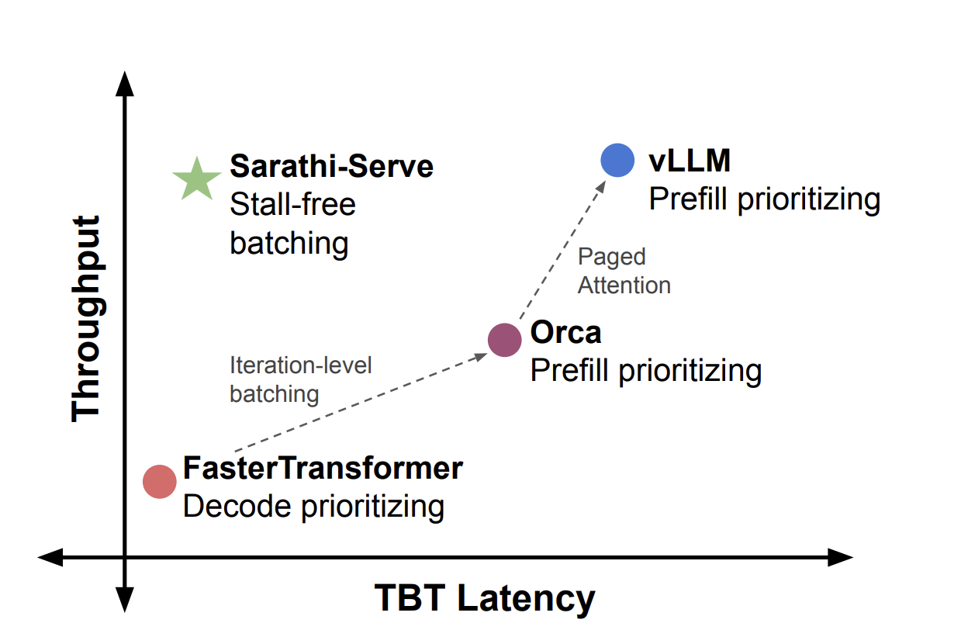
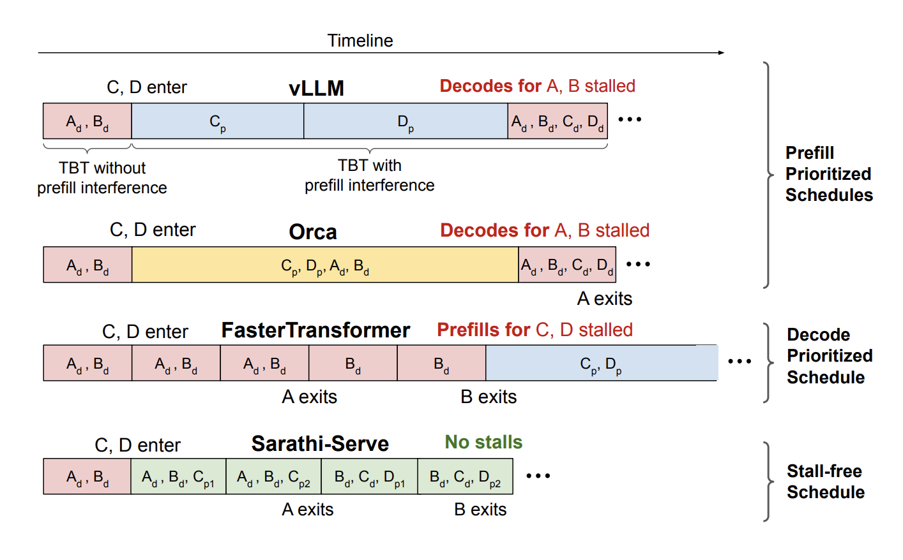
Chunked Prefill (Sarathi-Serve) Deepdive
Taming Throughput-Latency Tradeoff in LLM Inference with Sarathi-Serve

Slide 47




Performance Optimization
Better Kernels via FlashInfer & OpenAI Triton
Quantizations
FP8 Format Support
Weight Only Quantization Improvements
Via Marlin Kernel
Activation Quantization Framework
(W8A8, FP8, etc)
Guided Decoding Optimizations

Slide 48
Extensible Architectures
Prototype pipeline parallelism
Extensible memory manager
Extensible scheduler
torch.compile investigations

Slide 49
Strong OSS Community
Continuous benchmarks
resource needed!
Nightly wheels and Docker images
Commit to 2 week release cadence

Slide 50
Call for Contributors / Reviewers / Adopters
We are continuing to grow our reviewer and comitter base.
Please help us review PRs.
We are growing our comitter base as well, by demonstrating contributions over time.
Our roadmap comes from you, the vLLM community.
Don’t hesitate to reach out with your use case and feature requests.
We would love to learn more about how you are using vLLM.
vLLM is an open-source project, maintained by UC Berkeley, helped by organizations adopting vLLM.
We are not VC funded.
Can your organization help us in resources in any way? Talk to us!
Please email vllm-questions@lists.berkeley.edu if you can help (hardware, cloud credits etc.)!!

Slide 51






Building the fastest and easiest-to-use open-source LLM inference & serving engine!
https://github.com/vllm-project/vllm
https://vllm.ai
https://arxiv.org/abs/2309.06180
https://discord.gg/jz7wjKhh6g
https://twitter.com/vllm_project

Slide 52


Slide 53
The Third vLLM Meetup
Hosted by Roblox
April 2, 2024

Slide 54




Denis Goupil
Roger Wang

Slide 55
Agenda
vLLM meetup - April 2nd 2024
Online Serving Performance Benchmark
What’s next?
Q&A

Slide 56
Online Serving Performance Benchmark

Slide 57
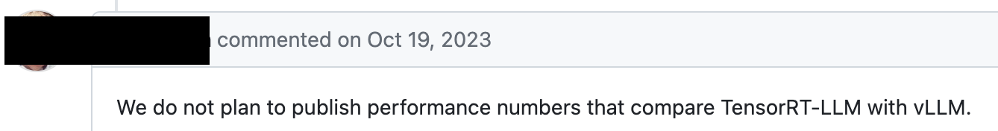
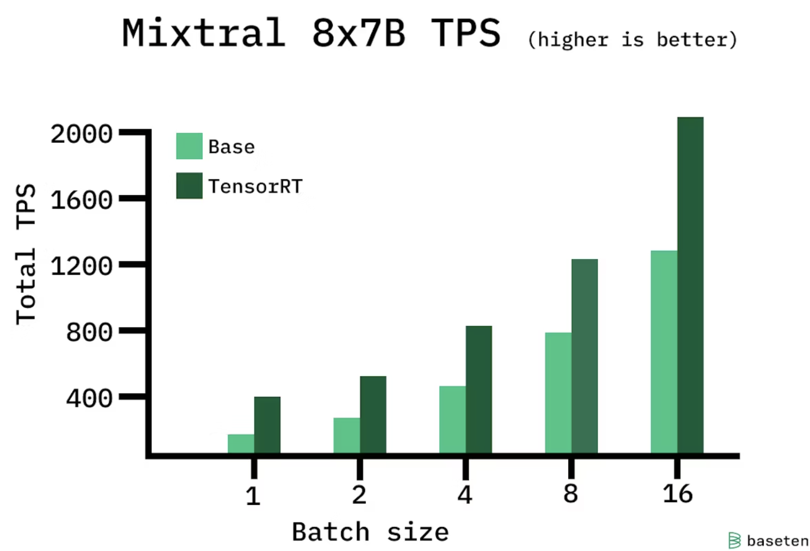
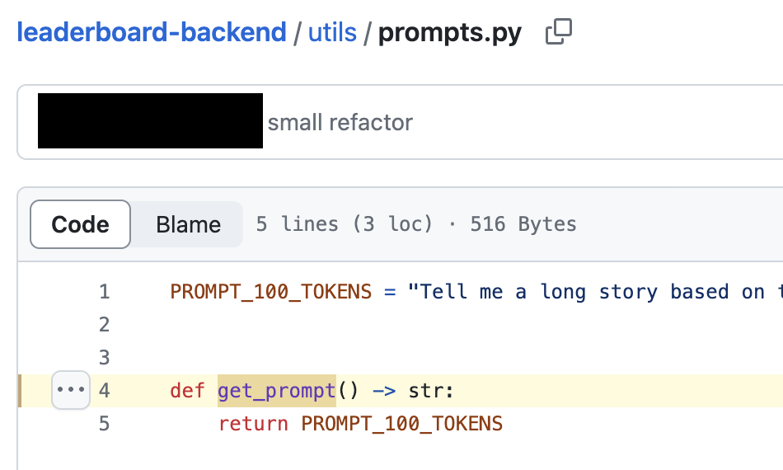
Why?
vLLM meetup - April 2nd 2024
vLLM (v0.2.5 btw)

Slide 58
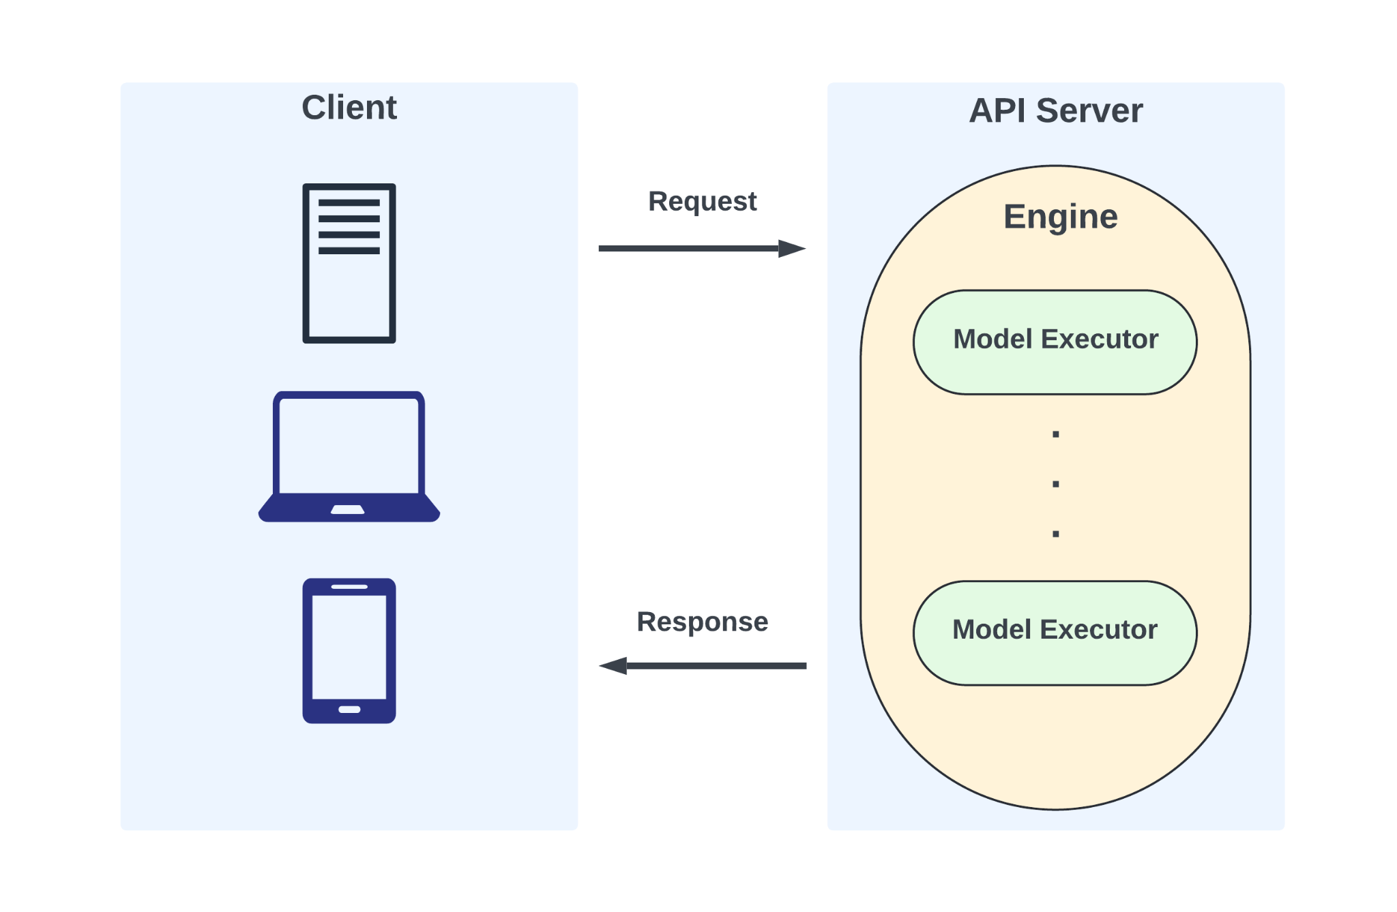
Why?
vLLM meetup - April 2nd 2024
Serving Benchmark
(better suited for online)
Engine
Benchmark
(better suited for offline)

Slide 59
vLLM meetup - April 2nd 2024
Benchmark Setup
Model:
meta-llama/Llama-2-7b-chat-hf (Llama Architecture)
mistralai/Mixtral-8x7B-Instruct-v0.1 (Mixture of Experts)
Dataset:
ShareGPT
Roblox Internal Luau Snippet
Dtype:
FP16 (float16)
Hardware:
A100-80G
H100

Slide 60
vLLM meetup - April 2nd 2024
Benchmark Setup
Backend/Framework:
vLLM v0.4.0
HuggingFace Text Generation Inference (TGI) v1.4.3
InternLM LMDeploy v0.2.5
TurboMind - implemented based on FasterTransformer (C++)
lmdeploy.pytorch - PyTorch (Python)
Nvidia TensorRT-LLM v0.8.0 (with Triton v24.02)
Microsoft DeepSpeed-MII v0.2.3
v0.2.3 does not work on H100 due to a bug
v0.2.2 does not work due to mixture-of-expert gate issues
Does not support streaming

Slide 61
vLLM meetup - April 2nd 2024
Benchmark Setup
Deployment
Docker deployment with default engine configurations
Tensor Parallelism: Llama-2-7B: TP = 1, Mixtral-8x7B: TP = 4
Cuda graph enabled whenever possible
For TensorRT-LLM (and Triton model repo):
max_batch_size: 128, max_input_len: 1024, max_output_len: 2048, decoupled: True, instance_group count: 128
Unfair to tune for individual backend(Implicit measurement of user-friendliness)
Traffic:
Duration: Sending requests for 5 minutes for each run
Request rate/s: 1, 2, 3, …, 10 for each run
Streaming
Code available at: https://github.com/vllm-project/vllm/blob/main/benchmarks/benchmark_serving.py

Slide 62
Metrics & Measures
vLLM meetup - April 2nd 2024
Time to first Token (TTFT) - lower the better
Time for the client to receive the first token from API server
Queue time + prefill + first decode
Measures batching & prefill performance
Represents end-user’s perceived latency when streaming
Time per Output Token (TPOT) - lower the better
Per request, the average of inter token latencies after first token
Measures average decode performance
Represents the average time it takes for end-user to receive the next “text” when streaming
For each request, end-to-end latency = TTFT + TPOT x (# of output tokens - 1)
Implicit/Qualitative:
Reliability
Model support
User-friendliness

Slide 63
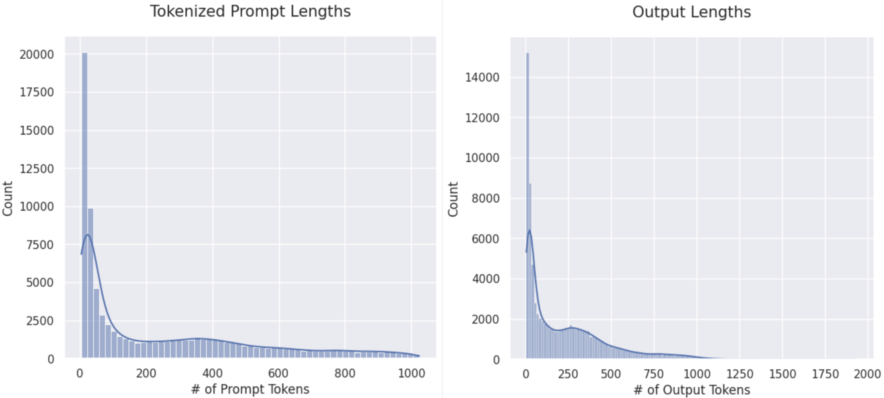
Dataset - ShareGPT
vLLM meetup - April 2nd 2024
~70K user-shared conversations from ShareGPT.com
Used by Vicuna-13B (fine-tuned Llama-13B)
Average: ~250
Average: ~220

Slide 64
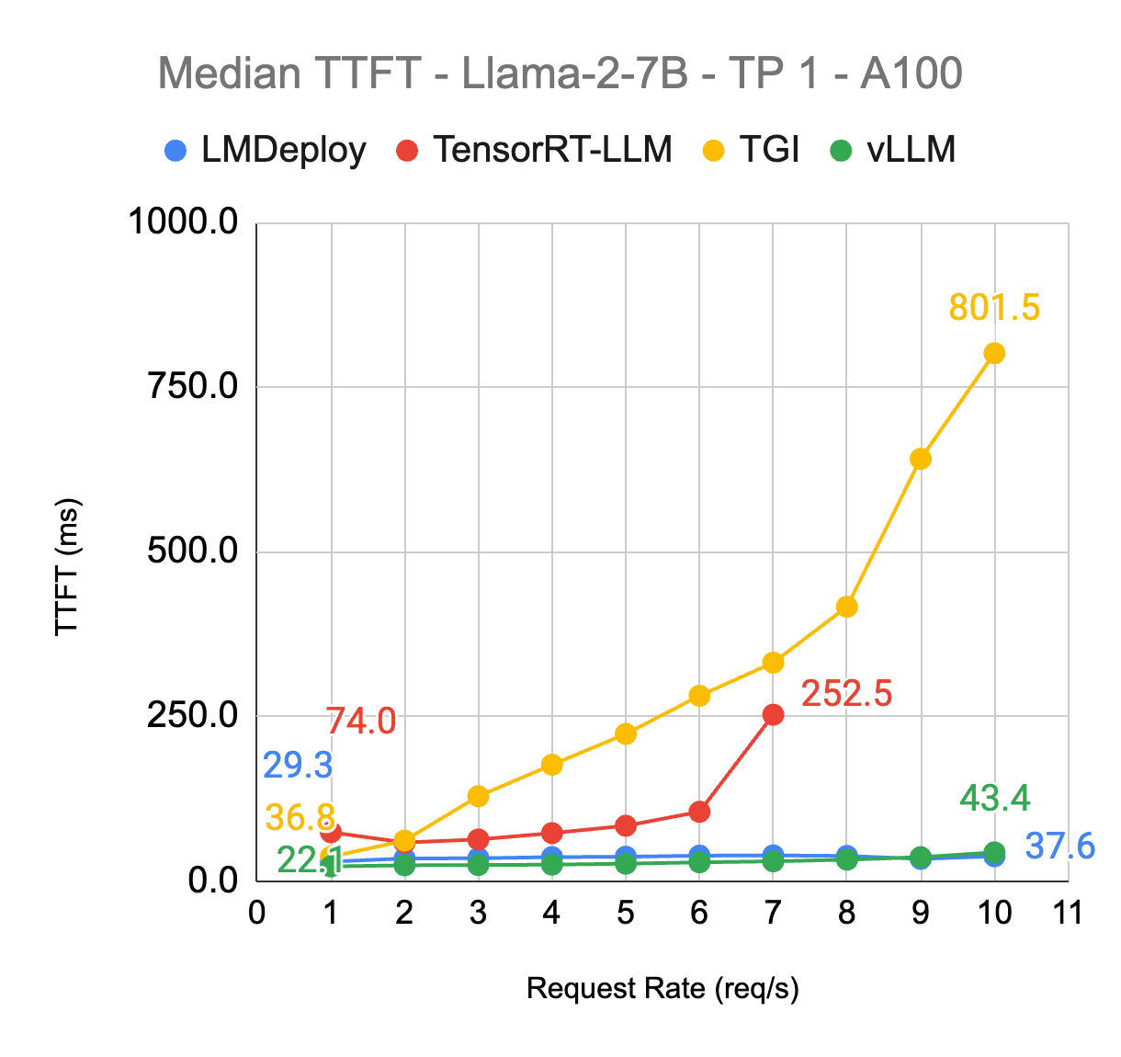
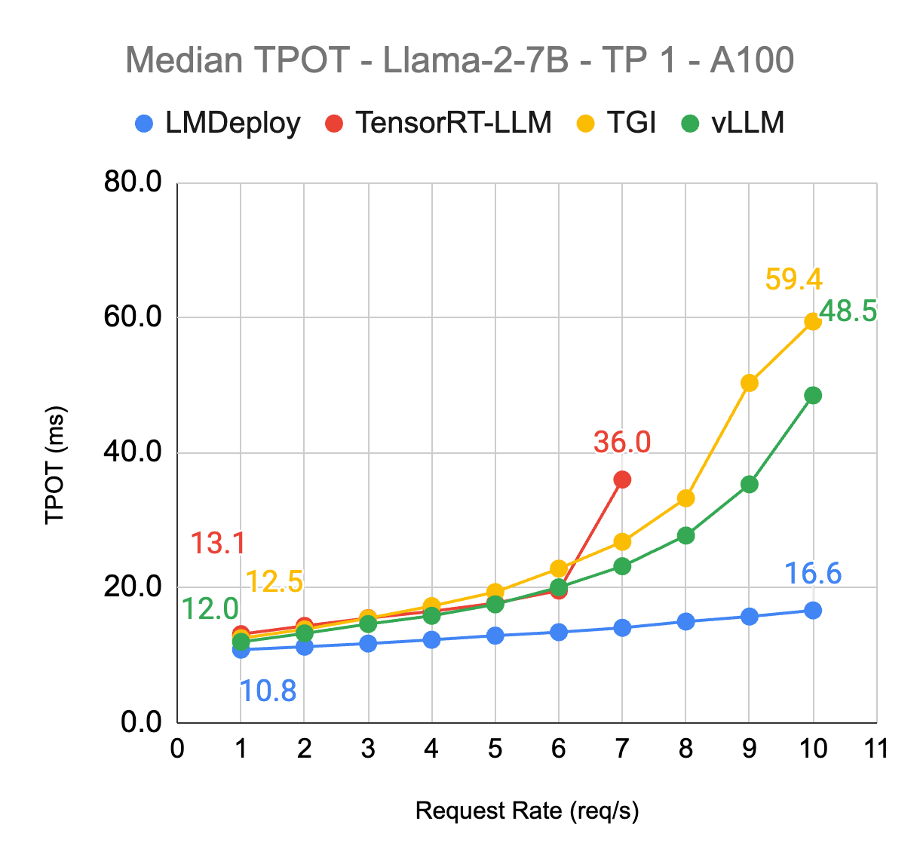
Llama2-7B - A100 TP1 - ShareGPT
vLLM meetup - April 2nd 2024
More pronounced gap
Linearly degrades
Best in class
Engine crashed beyond here; reliability issue

Slide 65
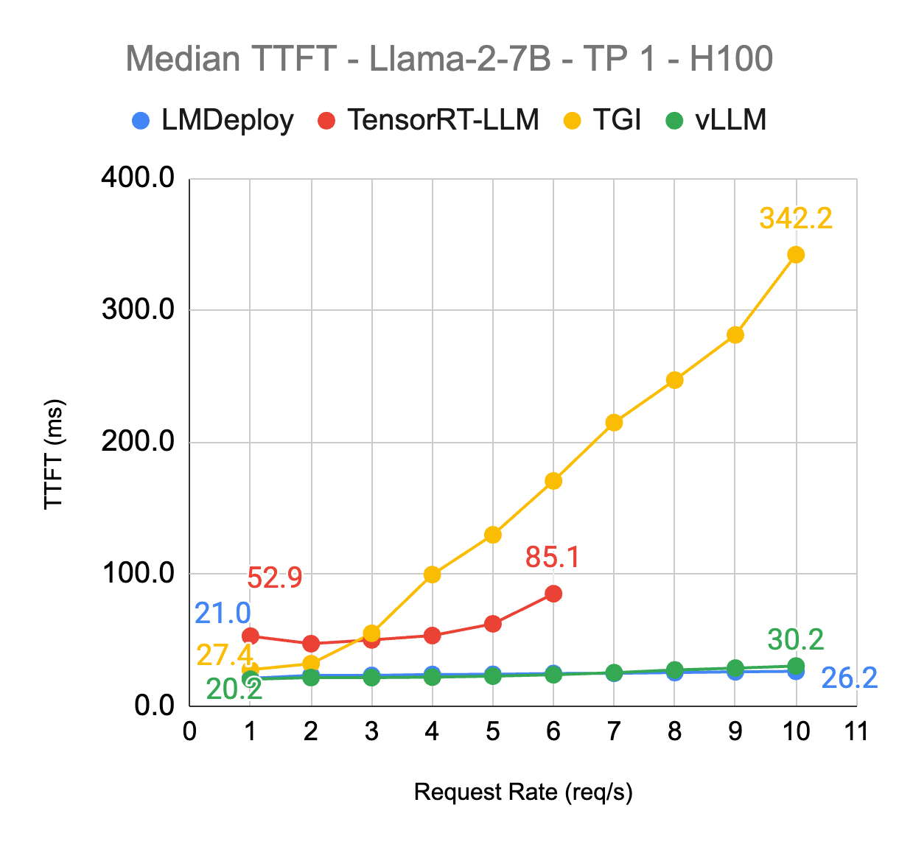
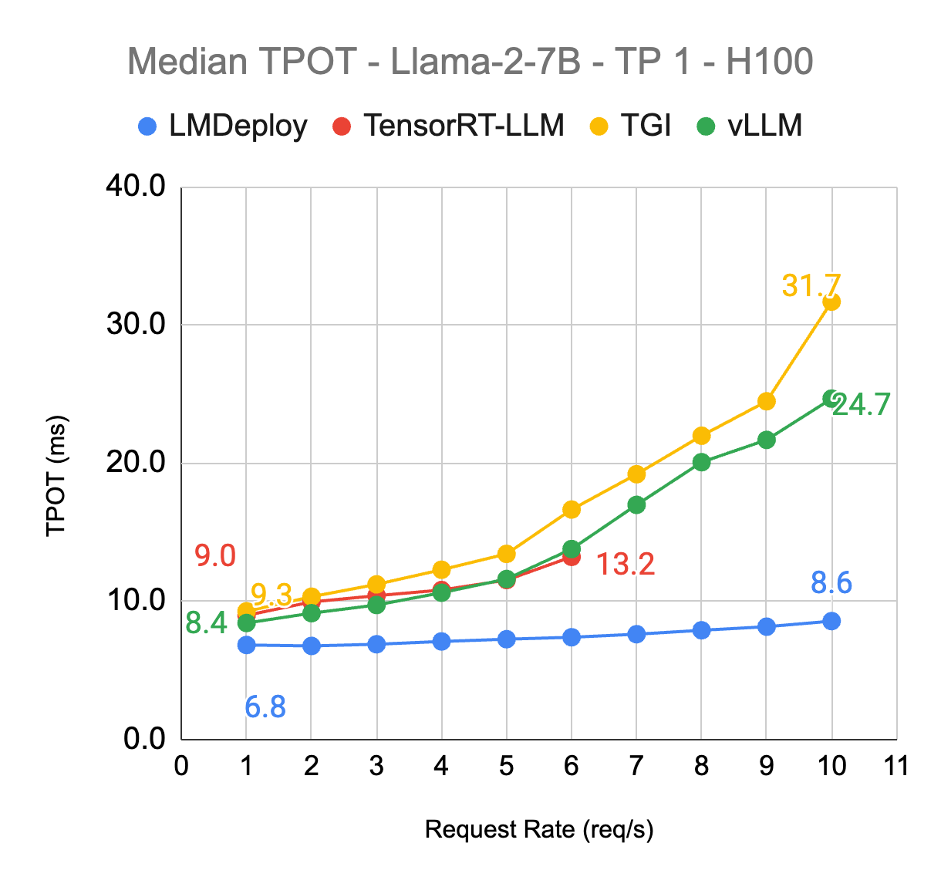
Llama2-7B - H100 TP1 - ShareGPT
vLLM meetup - April 2nd 2024

Slide 66
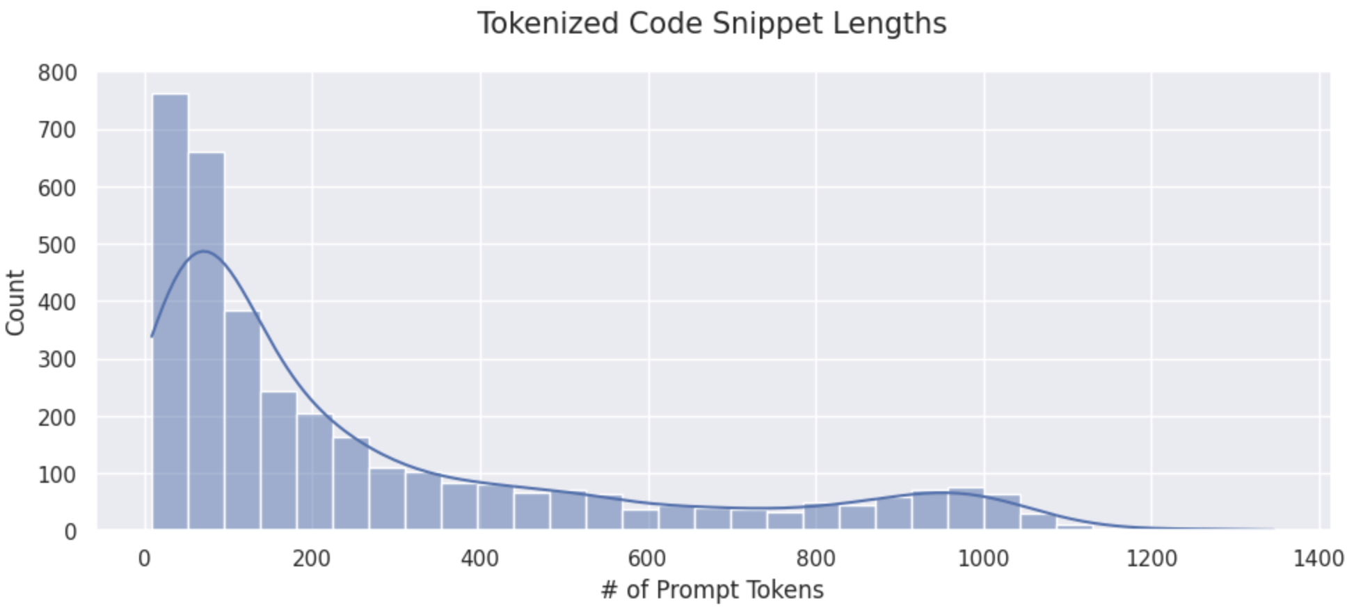
Dataset - Roblox Data
vLLM meetup - April 2nd 2024
3600 Luau (typed Lua) code snippets collected from production traffic
Input Average: 275, Output: 150

Slide 67
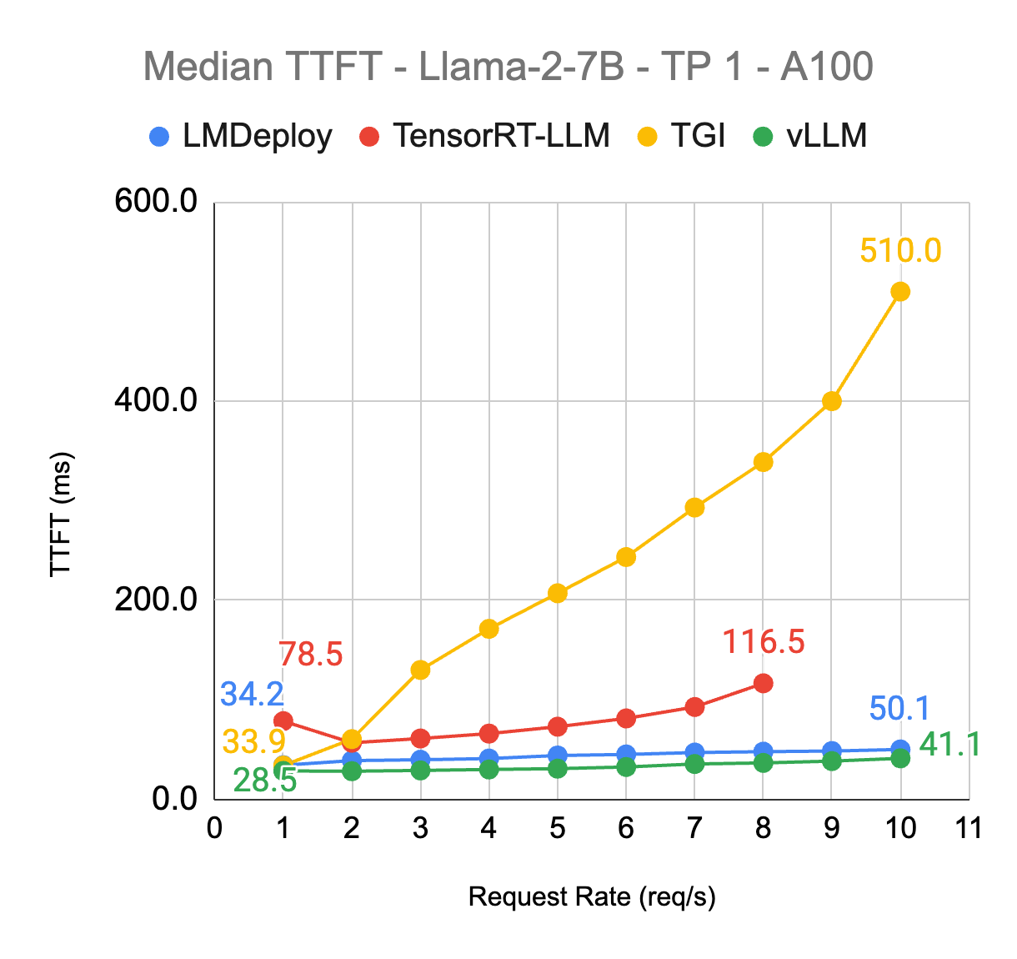
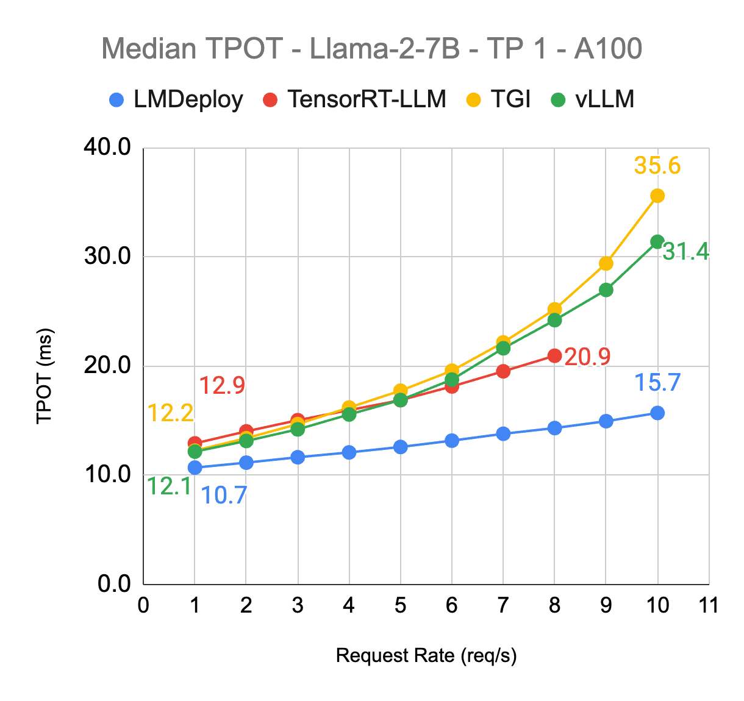
Llama2-7B - A100 TP1 - Roblox Code
vLLM meetup - April 2nd 2024

Slide 68
Takeaways
vLLM meetup - April 2nd 2024
Given the default deployment setup …
Llama2-7B
LMDeploy (TurboMind) is best in class for in both metrics
Only vLLM is able to keep up with the same TTFT performance, but worse in TPOT
TPOT Performance gap between LMDeploy and vLLM is more pronounced as request rate goes up.
TensorRT-LLM shows capacity and reliability issue for high traffic with no significant advantage in either TTFT or TPOT.
TGI: Poor TTFT performance (up to 10x worse than vLLM, almost linears scales with request rate), but no advantage in TPOT.

Slide 69
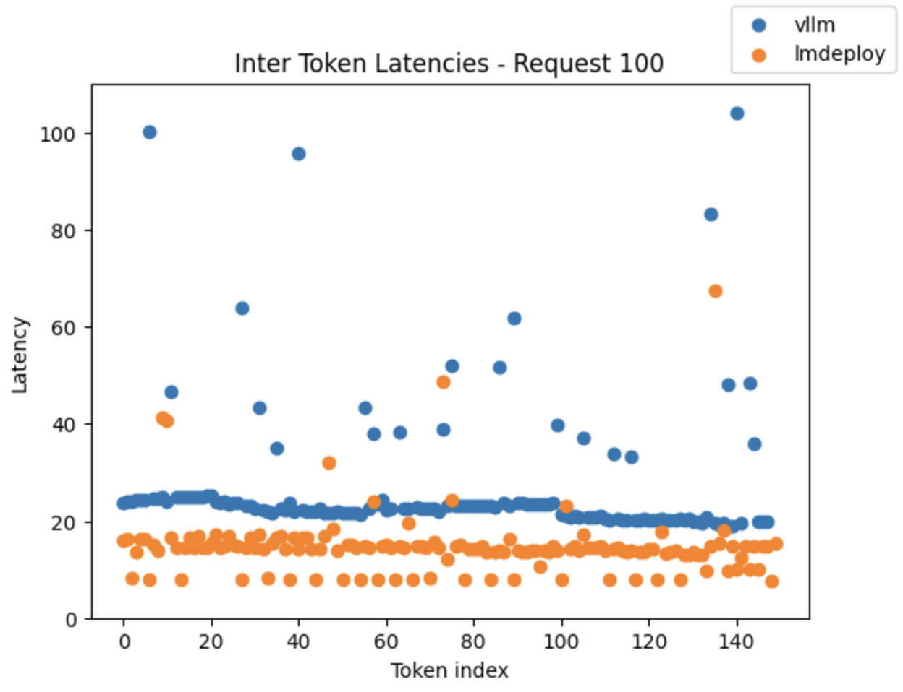
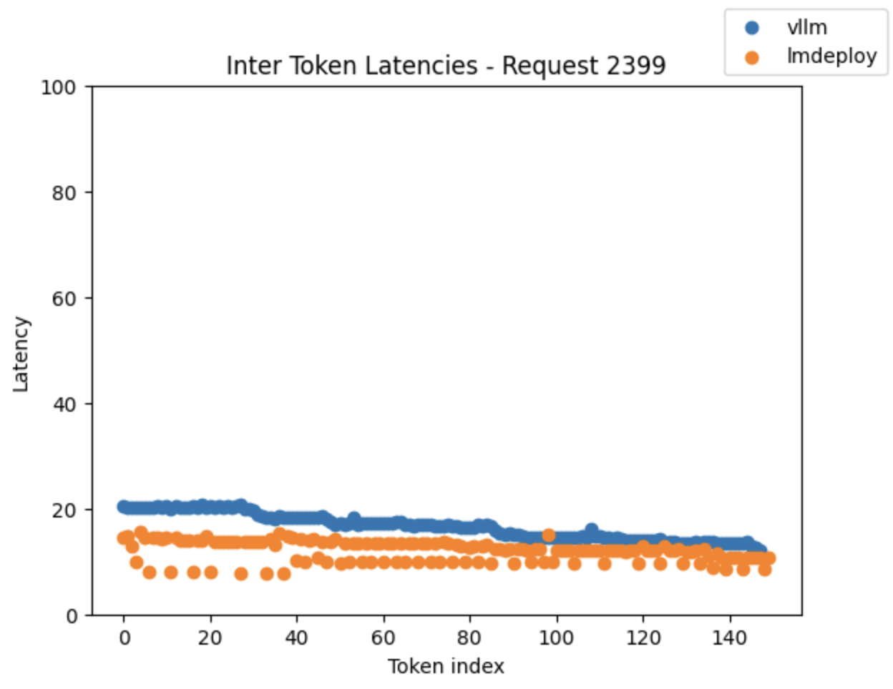
Room for Improvement - vLLM vs LMDeploy
vLLM meetup - April 2nd 2024
Llama-7B, Roblox Code Data (150 Output), 8 QPS (2400 requests in total)
Compare inter token latencies for a particular request
> 25ms (affected by prefill)
vLLM: 18% (44/149)
LMDeploy: 3% (4/149)
vLLM average: 16.6ms
LMDeploy average: 12 ms

Slide 70
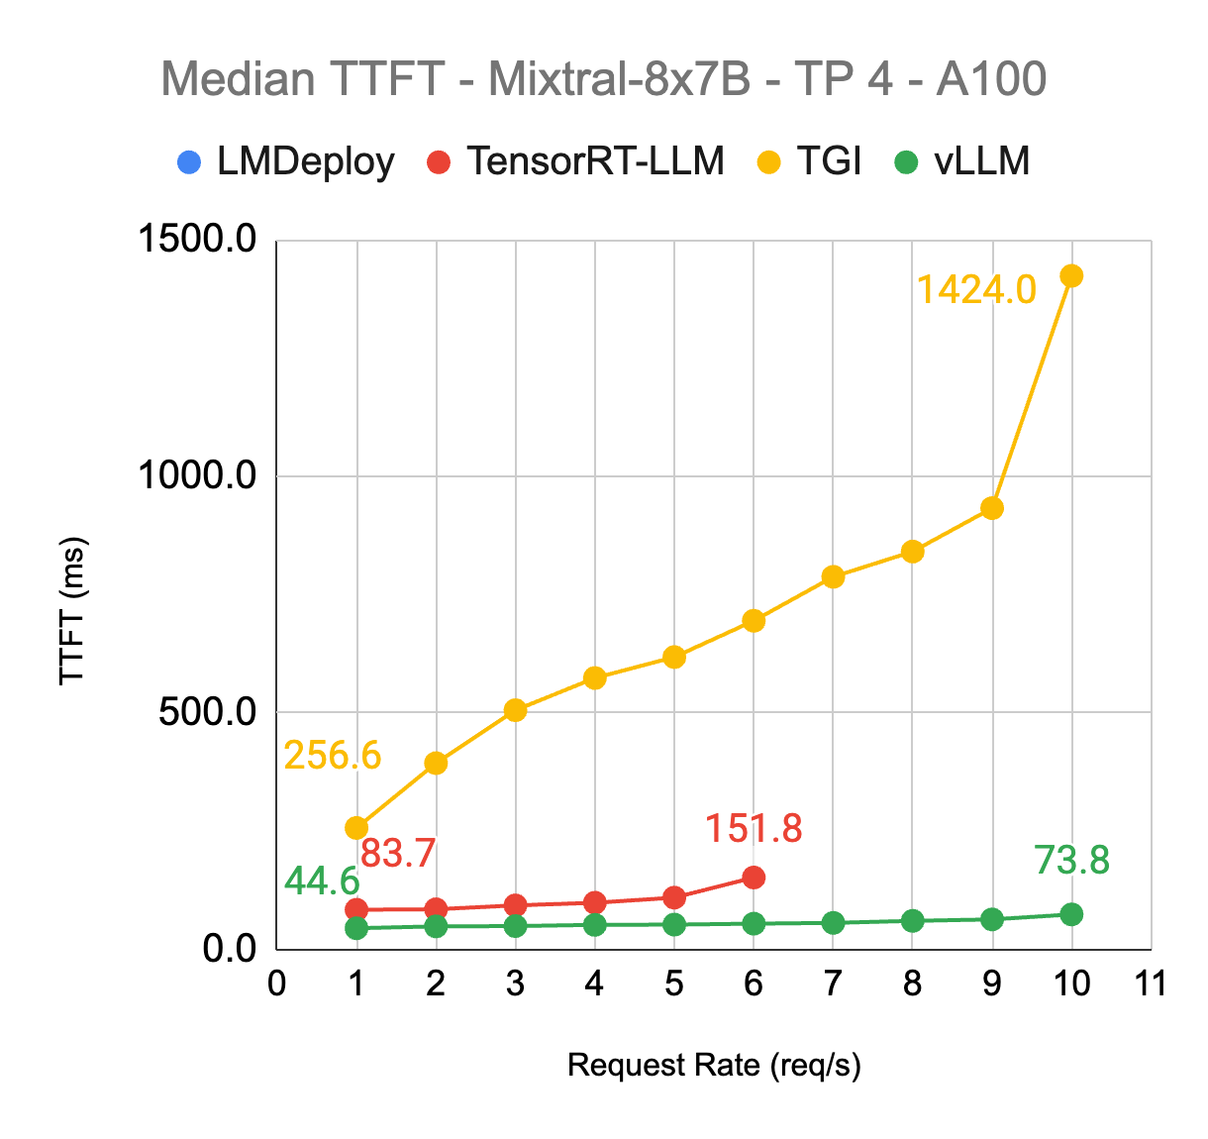
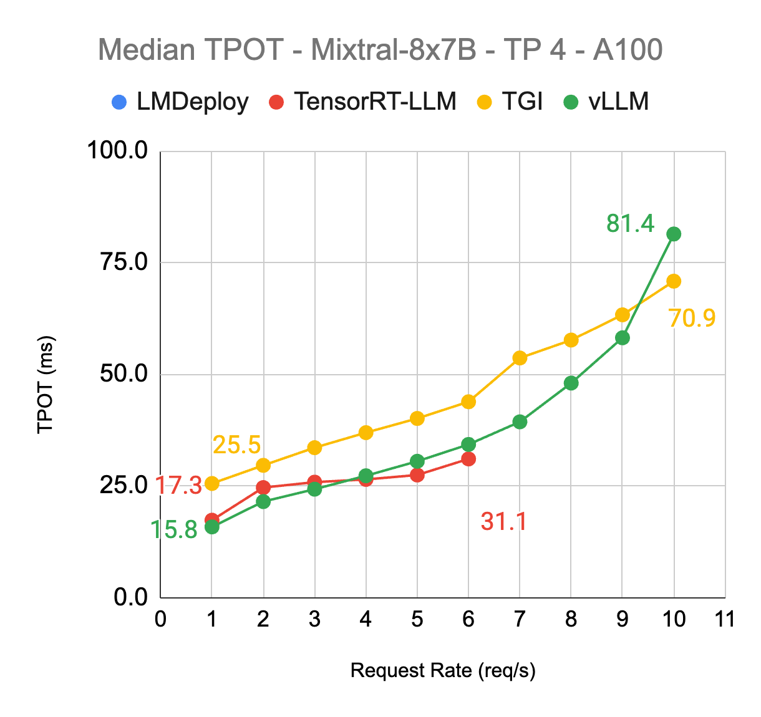
Mixtral8x7B - A100 TP4 - ShareGPT
vLLM meetup - April 2nd 2024
Tradeoff between TPOT and TTFT
(Prefill vs decode)
Best in class

Slide 71
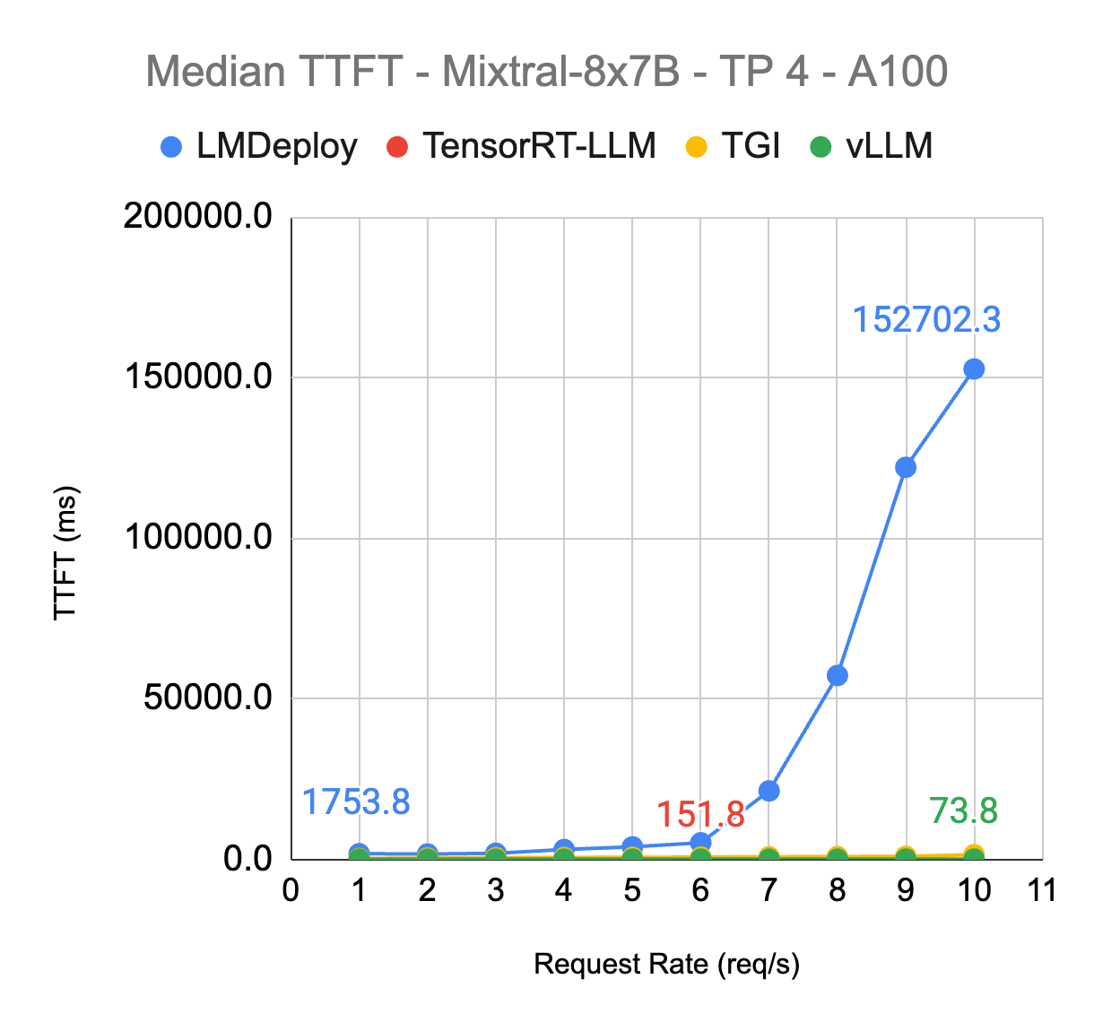
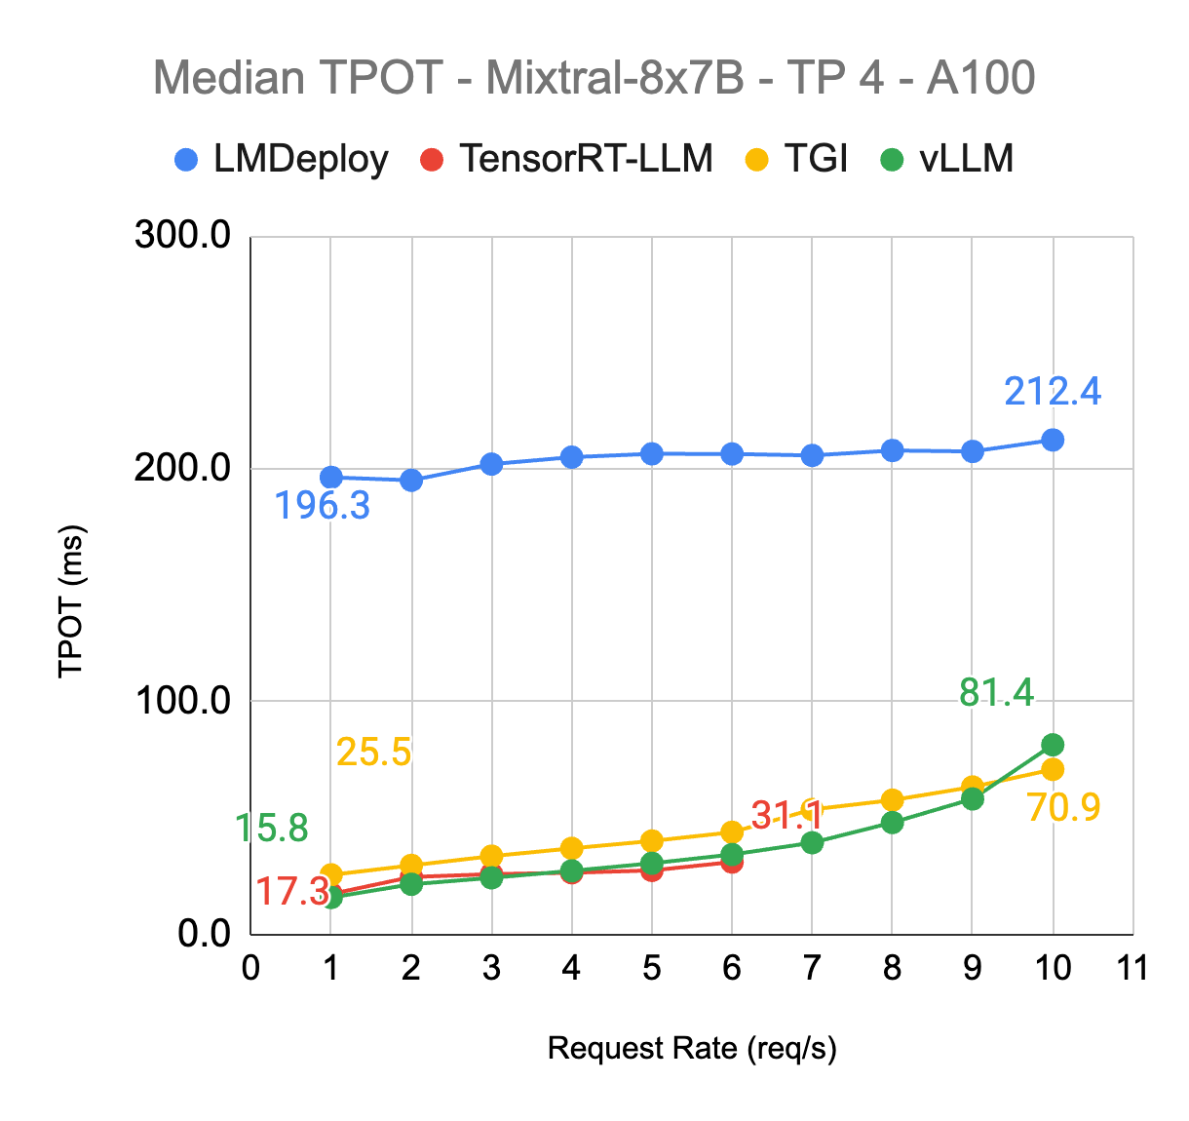
Mixtral8x7B - A100 TP4 - ShareGPT
vLLM meetup - April 2nd 2024
Over 2 mins…
10x worse

Slide 72
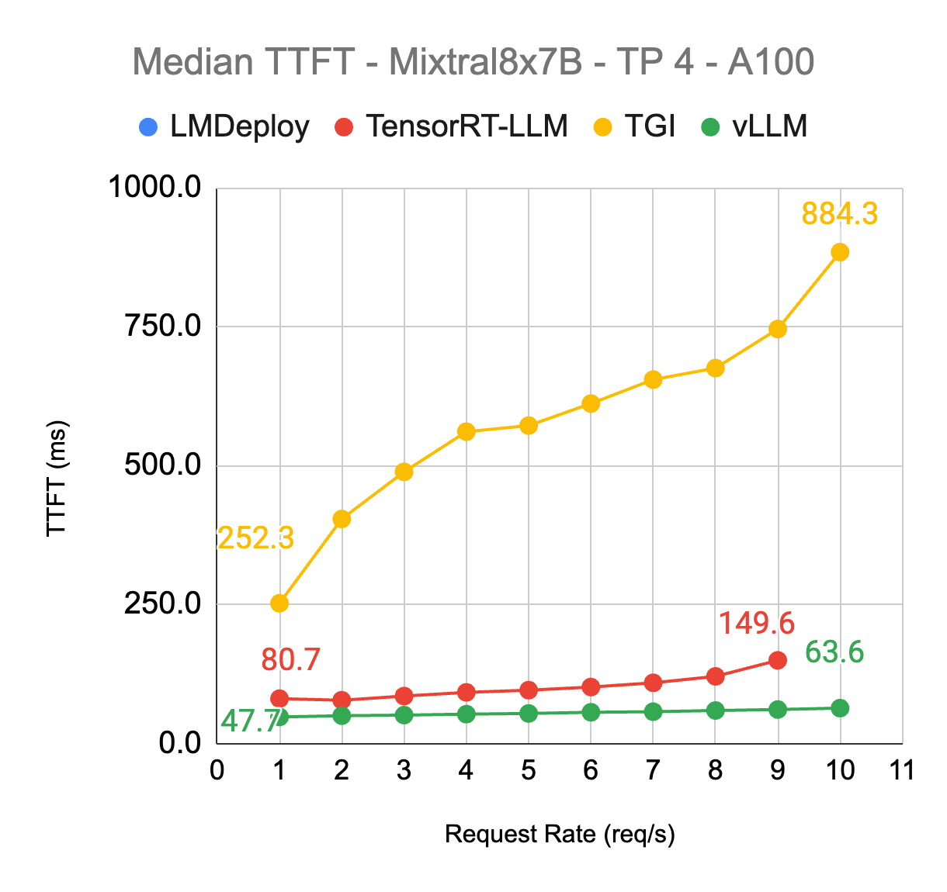
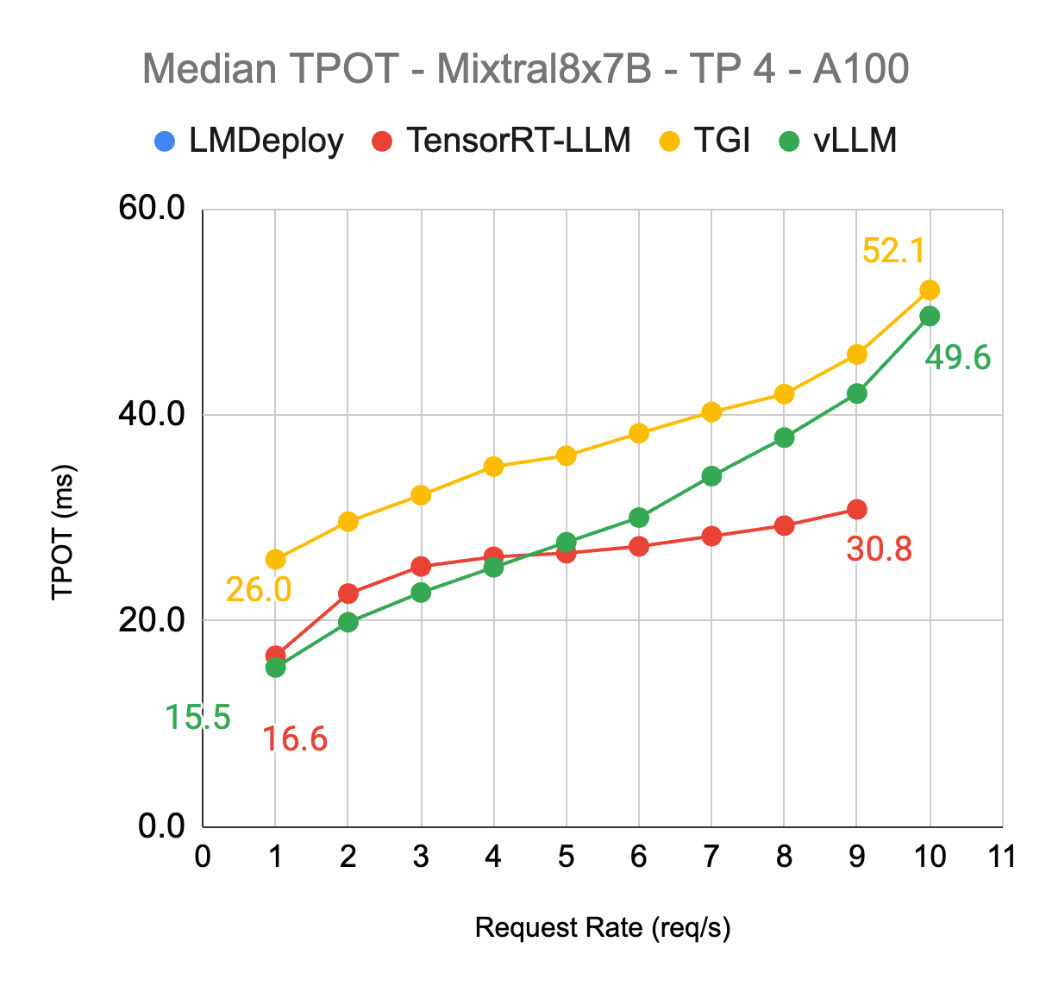
Mixtral8x7B - A100 TP4 - Roblox Code
vLLM meetup - April 2nd 2024

Slide 73
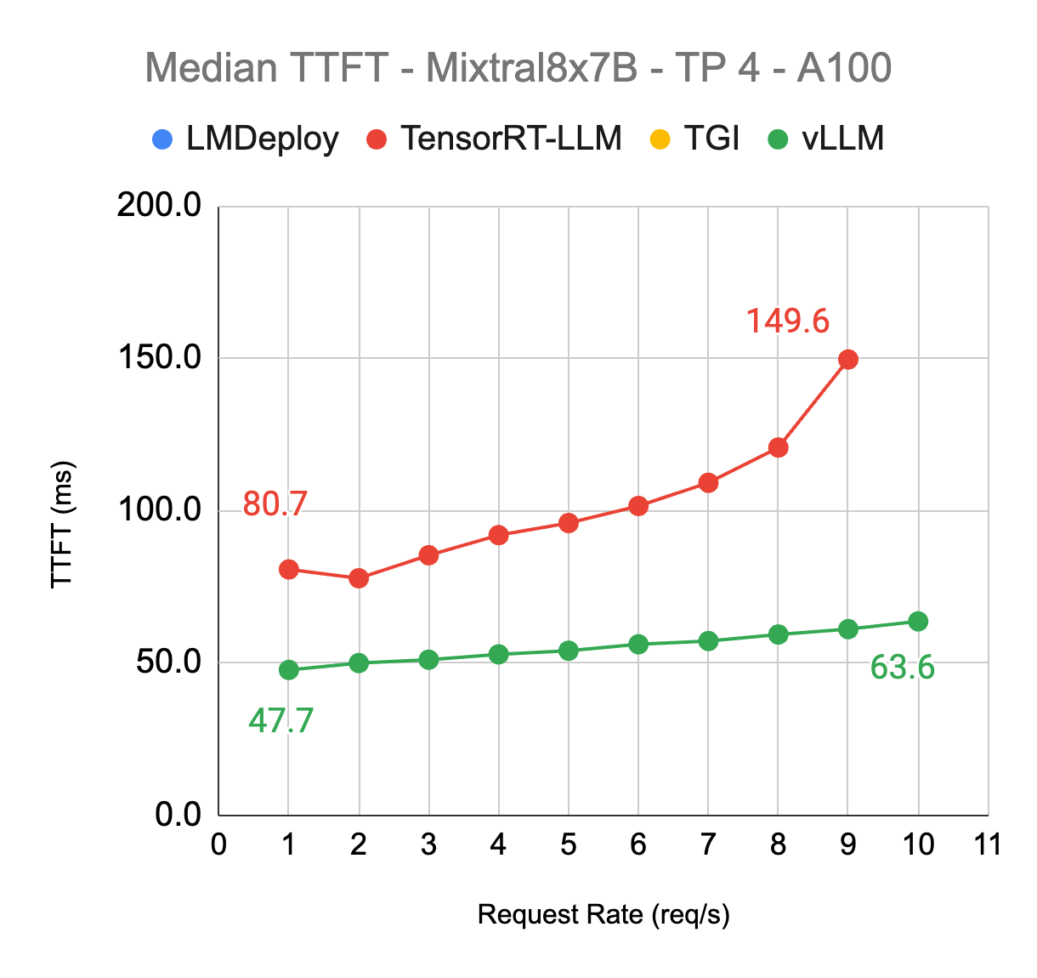
Mixtral8x7B - A100 TP4 - Roblox Code
vLLM meetup - April 2nd 2024

Slide 74
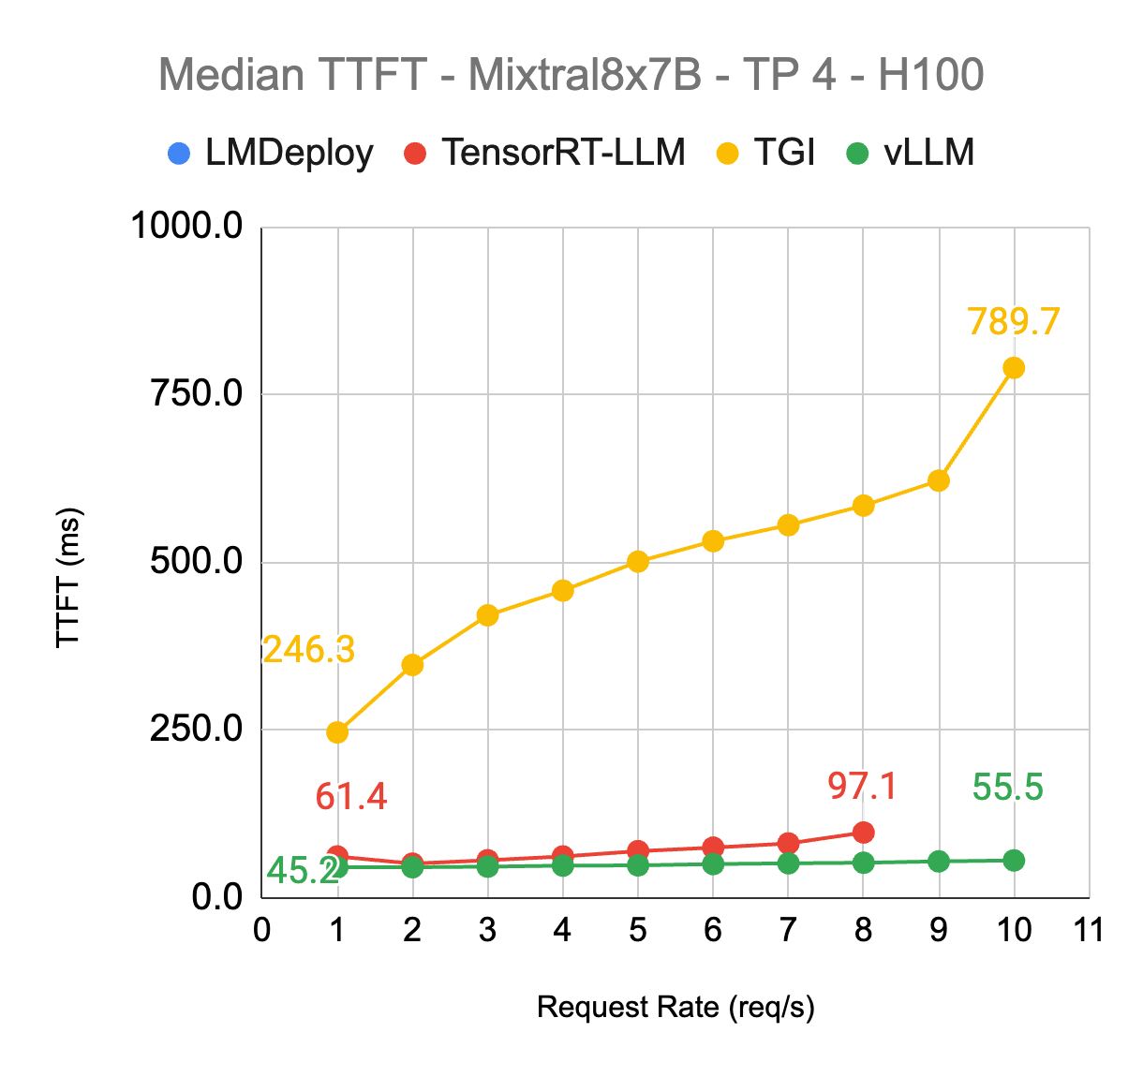
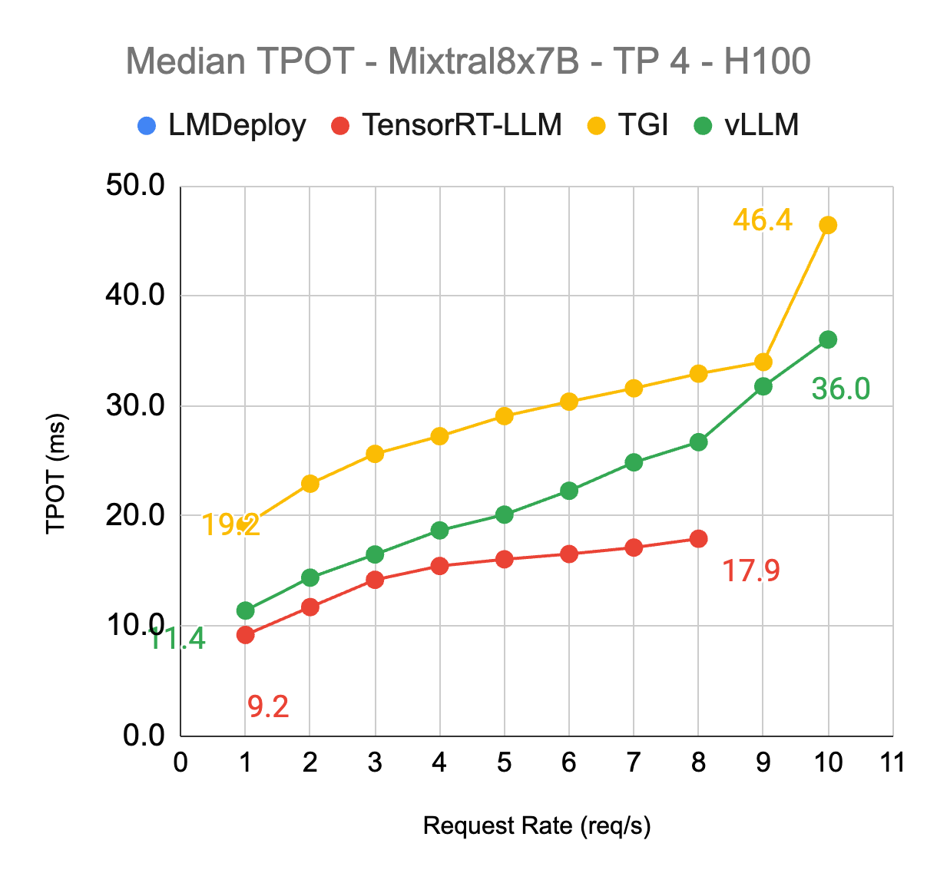
Mixtral8x7B - H100 TP4 - Roblox Code
vLLM meetup - April 2nd 2024
Latency advantage, but reliability issue

Slide 75
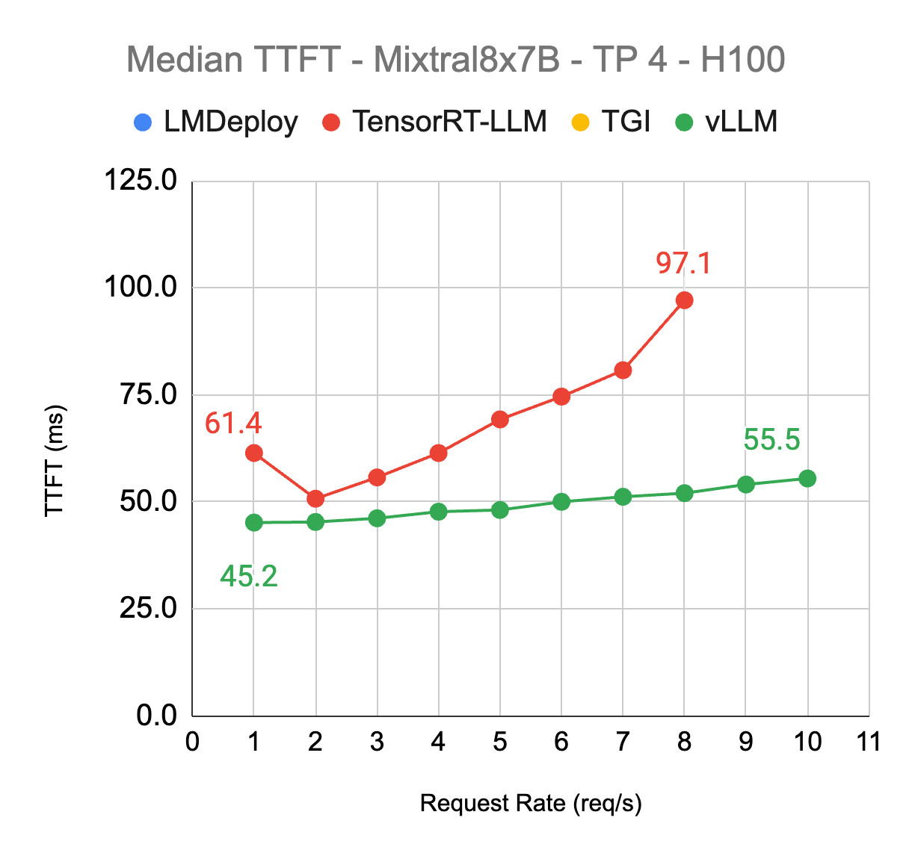
Mixtral8x7B - H100 TP4 - Roblox Code
vLLM meetup - April 2nd 2024
Latency advantage, but reliability issue

Slide 76
Takeaways
vLLM meetup - April 2nd 2024
Given the default deployment setup …
Mixtral 8x7B
Model support is important! (look at LMDeploy….)
vLLM always delivers the best TTFT performance across all traffic levels
with the best TPOT performance in low request-rate regime on A100
in sacrifice of TPOT in high request-rate regime because of prefill blocking decode.
TensorRT-LLM shows TPOT advantage on H100
2x-3x worse TTFT than vLLM
Reliability issue with high traffic

Slide 77
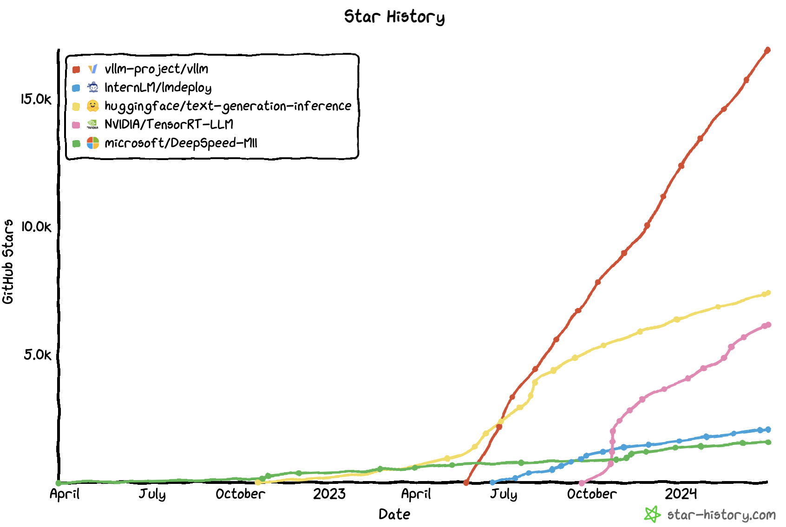
Conclusion
vLLM meetup - April 2nd 2024
Every inference backend has its pros and cons
We believe vLLM is the ideal backend for production workloads because of:
Best overall performance across all models & all traffic levels
Reliability & User-friendliness
Rapid development (model support, features, optimizations, etc)
Hardware support (Intel CPU, AMD GPU, TPU, Inferentia…)
Open Source community

Slide 78
What’s next?

Slide 79
Priorities for 2024
vLLM meetup - April 2nd 2024
Support for multi-modal model
Performance optimization
Stability, Reliability, Monitoring

Slide 80
Commitment to vLLM
vLLM meetup - April 2nd 2024
Engineering time
Hosting CI system
Allocate A100s and H100s to vLLM development and testing

Slide 81
Thank you!

